Slide 1
The NLM Update – Part 1 Expanding into the ‘Adjacent Possible’* *Stuart A. Kauffman
Betsy L. Humphreys, MLS, FMLA
Acting Director
National Library of Medicine
National Institutes of Health
U.S. Department of Health and Human Services
blh@nlm.nih.gov
May 19, 2015
Notes:
The NLM Update – Part 1 Expanding into the ‘Adjacent Possible’* *Stuart A. Kauffman
Betsy L. Humphreys, MLS, FMLA
Acting Director
National Library of Medicine
National Institutes of Health
U.S. Department of Health and Human Services
blh@nlm.nih.gov
May 19, 2015

Slide 2
Increasing the diversity of what can happen next* *Stuart A. Kauffman
“….. vision, uncanny judgment, courage, and perseverance ….”
NLM Board of Regents Resolution Honoring Donald A. B. Lindberg, February 10, 2015
http://www.nlm.nih.gov/news/bor_resolution_lindberg_2015.html
Notes:
Increasing the diversity of what can happen next* *Stuart A. Kauffman
“….. vision, uncanny judgment, courage, and perseverance ….”
NLM Board of Regents Resolution Honoring Donald A. B. Lindberg, February 10, 2015
http://www.nlm.nih.gov/news/bor_resolution_lindberg_2015.html

Slide 3
Fair Winds and Following Seas

Slide 4
NLM Working Group of the Advisory Committee to the NIH Director
Some of the members:
Charge:
Reviewing NLM’s mission, organization, and programmatic priorities
Articulating a strategic vision to ensure that NLM remains an international leader in biomedical and health information.
Report public on June 11, 2015 – broadcast and archived at http://videocast.nih.gov
Trudy MacKay, PhD
NC State
Current Chair, NLM Board
Alexa McCray, PhD
Harvard
Chris Shaffer, MS
OHSU
James Williams, II, MS
U. Colorado, Boulder
Notes:
NLM Working Group of the Advisory Committee to the NIH Director
Charge:
Reviewing NLM’s mission, organization, and programmatic priorities
Articulating a strategic vision to ensure that NLM remains an international leader in biomedical and health information.
Report public on June 11, 2015 – broadcast and archived at http://videocast.nih.gov

Slide 5
Advice and help during the transition…
Gail Yokote MS
UC Davis
NLM Board of Regents
(Next Chair)
Sandra Martin MSLS
Wayne State Univ.
NLM Board of Regents
Kris Alpi MPH MLS
NC State
NLM BLIRC
Kristi Holmes PhD
Northwestern
NLM BLIRC
Taneya Koonce MPH MSLS
Vanderbilt
NLM BLIRC
Gabe Rios MLIS
Indiana University
NLM BLIRC
Karen Butter, MS
UCSF
PMC NAC
Notes:
Advice and help during the transition…

Slide 6
Thoughtful input from many of you -- and we do keep asking for it….
June 2014 - Request for Information (RFI) in Preparation for 2016-2021 Contract Award of the National Network of Libraries of Medicine (NN/LM) [48 responses]
Aug. 2014 - RFI on Information Resources on Data-Related Standards Widely Used in Biomedicine (NIH BD2K Initiative)
Nov. 2014 – Requests for Public Comment on (1) HHS Notice of Proposed Rulemaking (NPRM) on Clinical Trials Registration and Results Submission at last! and (2) Broader NIH Policy [892 responses to NPRM]
Nov. 2014 – RFI on NIH BD2K Initiative Resources for Teaching and Learning Biomedical Big Data Management and Data Science
Feb. 2015 - RFI Regarding Deliberations of the Advisory Committee to the NIH Director (ACD) Working Group on the NLM [652 responses]
A partial list …..
THANK YOU!! – to everyone who responded
Notes:
Thoughtful input from many of you -- and we do keep asking for it….
June 2014 - Request for Information (RFI) in Preparation for 2016-2021 Contract Award of the National Network of Libraries of Medicine (NN/LM) [48 responses]
Aug. 2014 - RFI on Information Resources on Data-Related Standards Widely Used in Biomedicine (NIH BD2K Initiative)
Nov. 2014 – Requests for Public Comment on (1) HHS Notice of Proposed Rulemaking (NPRM) on Clinical Trials Registration and Results Submission at last! and (2) Broader NIH Policy [892 responses to NPRM]
Nov. 2014 – RFI on NIH BD2K Initiative Resources for Teaching and Learning Biomedical Big Data Management and Data Science
Feb. 2015 - RFI Regarding Deliberations of the Advisory Committee to the NIH Director (ACD) Working Group on the NLM [652 responses]
A partial list …..
THANK YOU!! – to everyone who responded

Slide 7
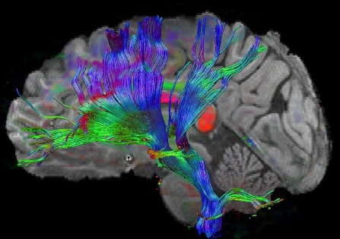
An obvious ‘Adjacent Possible’….
Societal expectations
Policy directives
Broad
Data
Sharing
Across
All
Domains
Technical capabilities
Scientific opportunities
Notes:
An obvious ‘Adjacent Possible’….

Slide 8
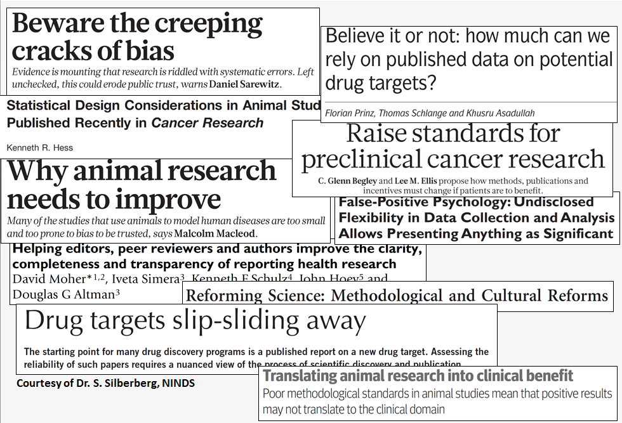
Reproducibility of Pre-Clinical Research
Notes:
Reproducibility of Pre-Clinical Research

Slide 9
Clinical Trials Registration & Results Submission Rulemaking Process (2008-- )
Announce in Unified Agenda
Agency develops draft NPRM
Departmental (HHS) review
Public comment period
Departmental review
OMB review
Publish final rule
Congressional review
Rule takes effect (e.g., 90 days after publication)
OMB review
Publish in Federal Register
Agency response to comments
We are here
Proposed NIH Policy also covers Phase 1 and trials of ANY intervention
Notes:
Clinical Trials Registration & Results Submission Rulemaking Process (2008-- )

Slide 10
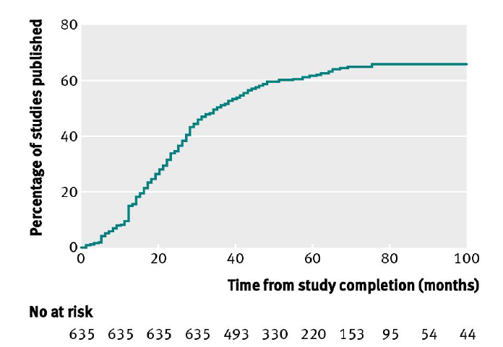
Less than 50% of NIH-funded trials published within 30 months of trial completion
Draft Review of Clinical Trials NPRM CONFIDENTIAL - NOT FOR DISTRIBUTION
10
Source: BMJ 2012;344:d7292.
Notes:
Source: Ross JS, Tse T, Zarin DA, Xu H, Zhou L, Krumholz HM. Publication of NIH funded trials registered in ClinicalTrials.gov: cross-sectional analysis. BMJ 2012;344:d7292.
10

Slide 11
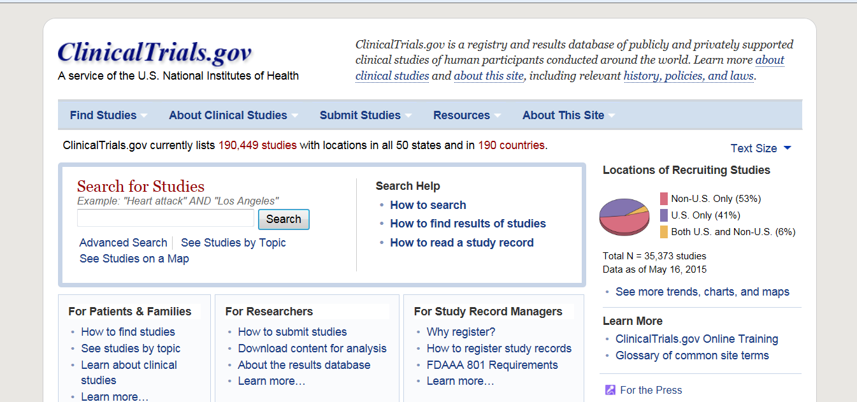
ClinicalTrials.gov
Summary results for 17,191 trials 5/18/2015

Slide 12
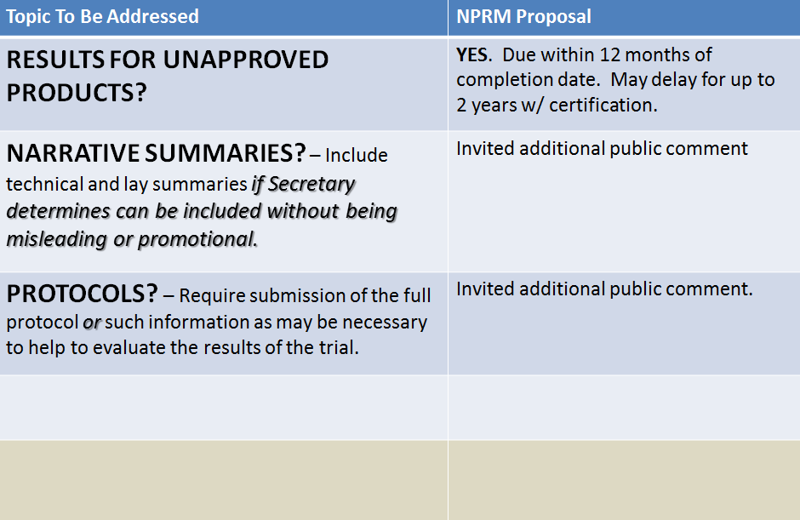
Range of Public Comments on NPRM
Draft Review of Clinical Trials NPRM CONFIDENTIAL - NOT FOR DISTRIBUTION
12
Notes:
Range of Public Comments on NPRM

Slide 13
Increasing Pressure to Use Common Data Elements in Clinical Research
http://www.nlm.nih.gov/cde/index.html
Notes:
Increasing Pressure to Use Common Data Elements in Clinical Research

Slide 14
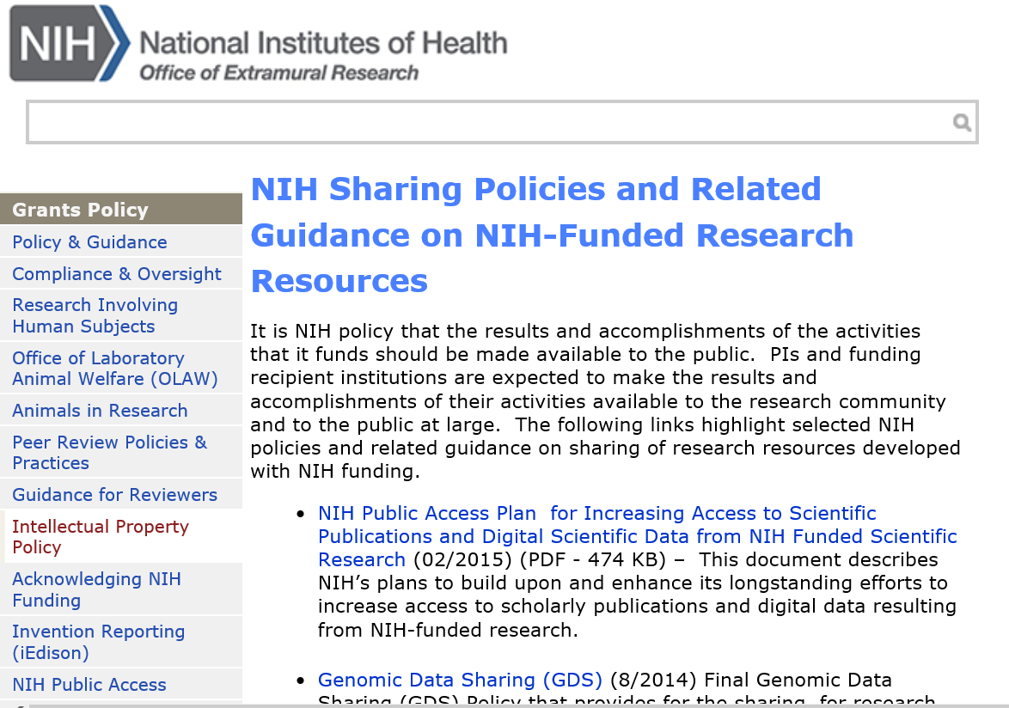

Slide 15
NIH Plan: Digital Scientific Data
Require Data Management and Sharing Plans
Ensure Policy Considerations are Addressed
Evaluate Data Management Plans
Support for Data Management
Leverage Existing Archives and Repositories
Improve Public Access to Scientific Data
Optimize Accessibility, Interoperability, and Long-Term Stewardship
Develop Attribution for Scientific Data
Support Training and Workforce Development
Notify Researchers of Obligations
Ensure compliance with data management plans and policies
Cooperate with the Private Sector
Conduct cost-benefit analysis
Assess Long-Term Preservation Needs
Notes:
NIH Plan: Digital Scientific Data
Require Data Management and Sharing Plans
Ensure Policy Considerations are Addressed
Evaluate Data Management Plans
Support for Data Management
Leverage Existing Archives and Repositories
Improve Public Access to Scientific Data
Optimize Accessibility, Interoperability, and Long-Term Stewardship
Develop Attribution for Scientific Data
Support Training and Workforce Development
Notify Researchers of Obligations
Ensure compliance with data management plans and policies
Cooperate with the Private Sector
Conduct cost-benefit analysis
Assess Long-Term Preservation Needs

Slide 16
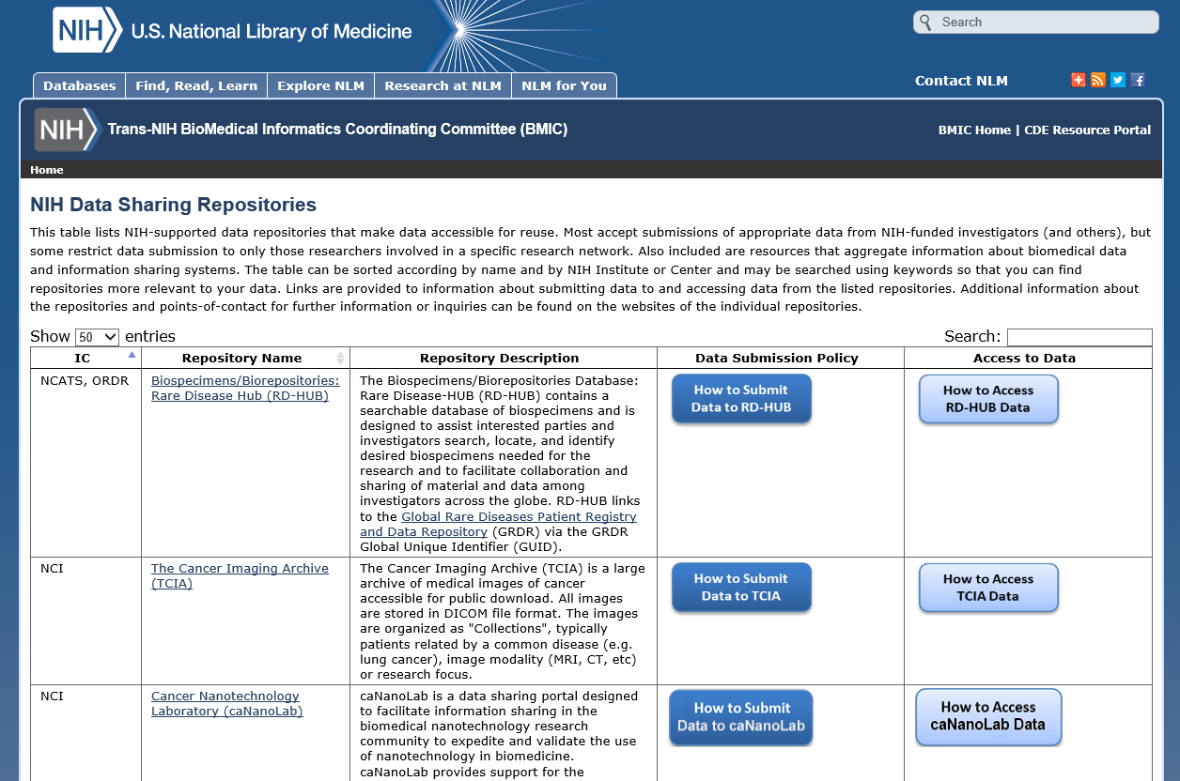
There are good repositories for some types of data…
Notes:
There are good repositories for some types of data…

Slide 17
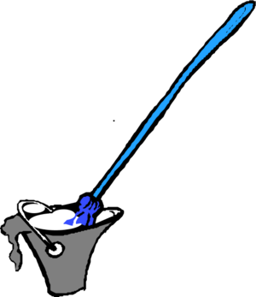
But not all ….
For many domains, we have
An imminent flood of data
Little or no data infrastructure
Notes:
But not all ….
For many domains, we have
An imminent flood of data
Little or no data infrastructure

Slide 18
NIH Big Data to Knowledge (BD2K) http://datascience.nih.gov/bd2k
One of its principal goals:
To facilitate broad use of biomedical digital assets by making them discoverable, accessible, and citable.
NIH Big Data to Knowledge (BD2K)
Who will do what? NIH? NLM? Your institution?
Your library? You?
Notes:
NIH Big Data to Knowledge (BD2K) http://datascience.nih.gov/bd2k
One of its principal goals:
To facilitate broad use of biomedical digital assets by making them discoverable, accessible, and citable.
NIH Big Data to Knowledge (BD2K)
Who will do what? NIH? NLM? Your institution?
Your library? You?

Slide 19
Basic Questions
How many biomedical research datasets are generated in a year?
What, exactly, is a “dataset”?
By whom, how, and for what purposes are currently available datasets used?
What is the current amount of investment in data infrastructure?
Who owns and operates the existing infrastructure?
What is the nature of the existing infrastructure and the data served by it?
Notes:
Basic Questions
How many biomedical research datasets are generated in a year?
What, exactly, is a “dataset”?
By whom, how, and for what purposes are currently available datasets used?
What is the current amount of investment in data infrastructure?
Who owns and operates the existing infrastructure?
What is the nature of the existing infrastructure and the data served by it?

Slide 20
Priorities?
All data are not created equal - which data should be:
Shared?
Indexed or otherwise made discoverable?
Deposited in a repository?
Curated?
Preserved?
Costs rise dramatically from sharing to preserving
Perhaps decide based on likely uses of the data? e.g.
Better understand the associated scientific paper?
Aggregate with other similar data for analysis?
Perhaps decide based on demonstrated value, i.e., use over some period?
Notes:
Priorities?
All data are not created equal - which data should be:
Shared?
Indexed or otherwise made discoverable?
Deposited in a repository?
Curated?
Preserved?
Costs rise dramatically from sharing to preserving
Perhaps decide based on likely uses of the data? e.g.
Better understand the associated scientific paper?
Aggregate with other similar data for analysis?
Perhaps decide based on demonstrated value, i.e., use over some period?

Slide 21
Local Questions=Opportunities
How will your institution support expanding data sharing mandates for funded investigators?
What should a current - or prospective - funded investigator do differently right now?
What are potential roles for libraries and librarians?
This is definitely an interdisciplinary team sport
Notes:
Local Questions=Opportunities
How will your institution support expanding data sharing mandates for funded investigators?
What should a current - or prospective - funded investigator do differently right now?
What are potential roles for libraries and librarians?
This is definitely an interdisciplinary team sport

Slide 22
New RFA: NLM Supplements to NIH Grants for Informationist Services
More NIH Institutes & Centers involved (14)
More types of grants eligible
Applications due: July 17, 2015
http://grants.nih.gov/grants/guide/pa-files/PA-15-249.html
Previous awards: 8 in 2012, 11 in 2014
Information Session TODAY
Tuesday, May 19, 4:30-6 pm
Rm 17A
Dr. Alan Vanbierliet
NLM Extramural Programs
Notes:
New RFA: NLM Supplements to NIH Grants for Informationist Services
More NIH Institutes & Centers involved (14)
More types of grants eligible
Applications due: July 17, 2015
http://grants.nih.gov/grants/guide/pa-files/PA-15-249.html
Previous awards: 8 in 2012, 11 in 2014

Slide 23
Some 2014 Examples
R01 AR-062002 Allen, Matthew, IUPUI. Grant title: Enhancing Bone Strength Using Combination Drug Therapy. Elizabeth Whipple, Lilly Library
R01 AG-040211 Galvin, James, NYU. Grant title: Multicultural Community Dementia Screening. Alice Graff and Joseph Nicolson, NYUHSL.
R01 DE-022031 Hall, Steven, UCSF. Grant title: Mass Spectrometry Tools in Pursuit of Salivary Biomarkers of Sjogren’s Syndrome. Megan Laurance, HSL/Center for Knowledge Management
R01 DC-011329, Liebold, Lori, UNC-Chapel Hill. Grant title: Susceptibility to and Release from Masking in Infancy and Childhood. Barbara Renner, Barrie Hayes and Kathleen McGraw, HSL
R01 AG-041823 Reynolds, Angela, VCU. Grant title: Age Dependent Mechanical Ventilator-Induced Inflammation: Modeling and Experiments. Julie Arendt, John Cyrus, Margaret Henderson, Martha Roseberry
Ariel Deardorff, NLM Associate Fellow, will conduct
a focus group today with some current/previous recipients
to discuss impact/value
Notes:
Some 2014 Examples
R01 AR-062002 Allen, Matthew, IUPUI. Grant title: Enhancing Bone Strength Using Combination Drug Therapy. Elizabeth Whipple, Lilly Library
R01 AG-040211 Galvin, James, NYU. Grant title: Multicultural Community Dementia Screening. Alice Graff and Joseph Nicolson, NYUHSL.
R01 DE-022031 Hall, Steven, UCSF. Grant title: Mass Spectrometry Tools in Pursuit of Salivary Biomarkers of Sjogren’s Syndrome. Megan Laurance, HSL/Center for Knowledge Management
R01 DC-011329, Liebold, Lori, UNC-Chapel Hill. Grant title: Susceptibility to and Release from Masking in Infancy and Childhood. Barbara Renner, Barrie Hayes and Kathleen McGraw, HSL
R01 AG-041823 Reynolds, Angela, VCU. Grant title: Age Dependent Mechanical Ventilator-Induced Inflammation: Modeling and Experiments. Julie Arendt, John Cyrus, Margaret Henderson, Martha Roseberry

Slide 24
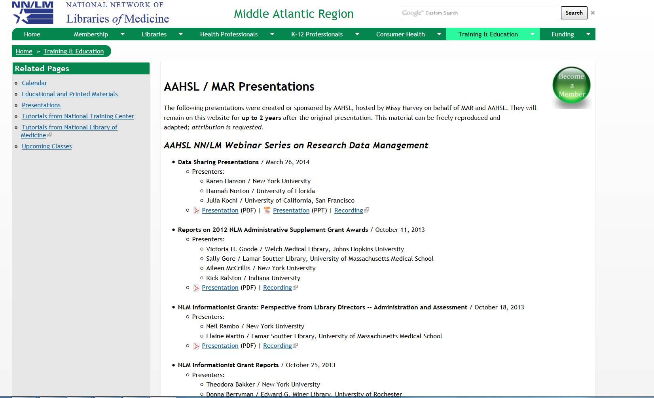
Lessons from 2012 Informationist Supplements
http://nnlm.gov/mar/training/aahsl
Notes:
Lessons from 2012 Informationist Supplements

Slide 25
Electronic Health Records (EHRs) – another key source of ‘Big Data’
And potential big opportunities in:
clinical decision support,
health care improvement,
public health
research
Coming soon: updates to NLM’s Health IT pages and a new Health IT RSS feed
Notes:
Electronic Health Records (EHRs) – another key source of ‘Big Data’
And potential big opportunities in:
clinical decision support,
health care improvement,
public health
research
Coming soon: updates to NLM’s Health IT pages and a new Health IT RSS feed

Slide 26
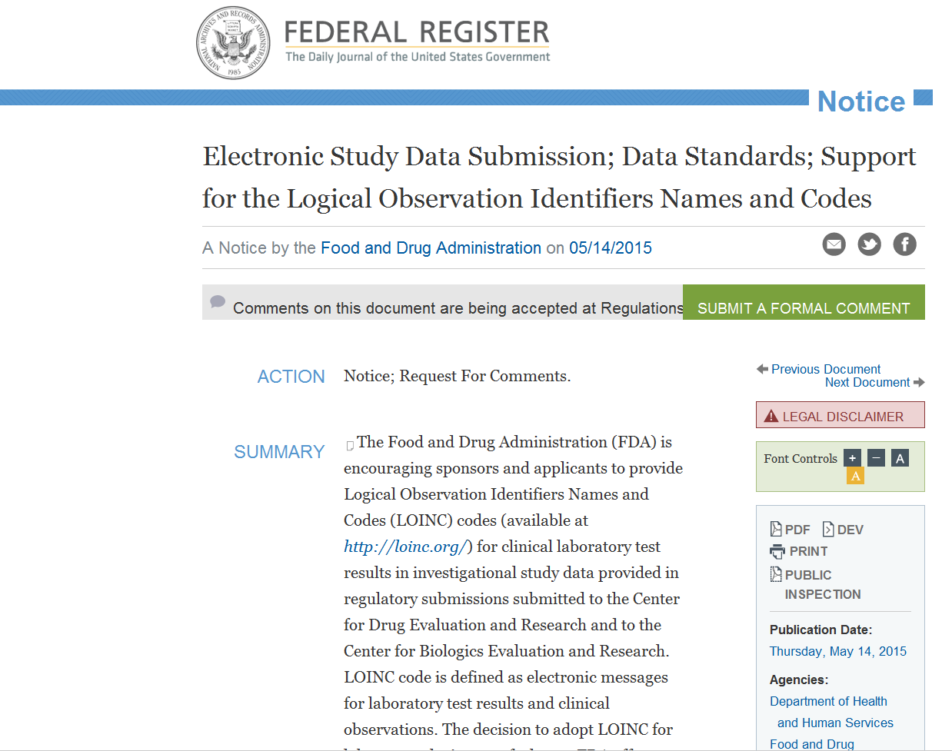
Federal Register
Notes:
Federal Register

Slide 27
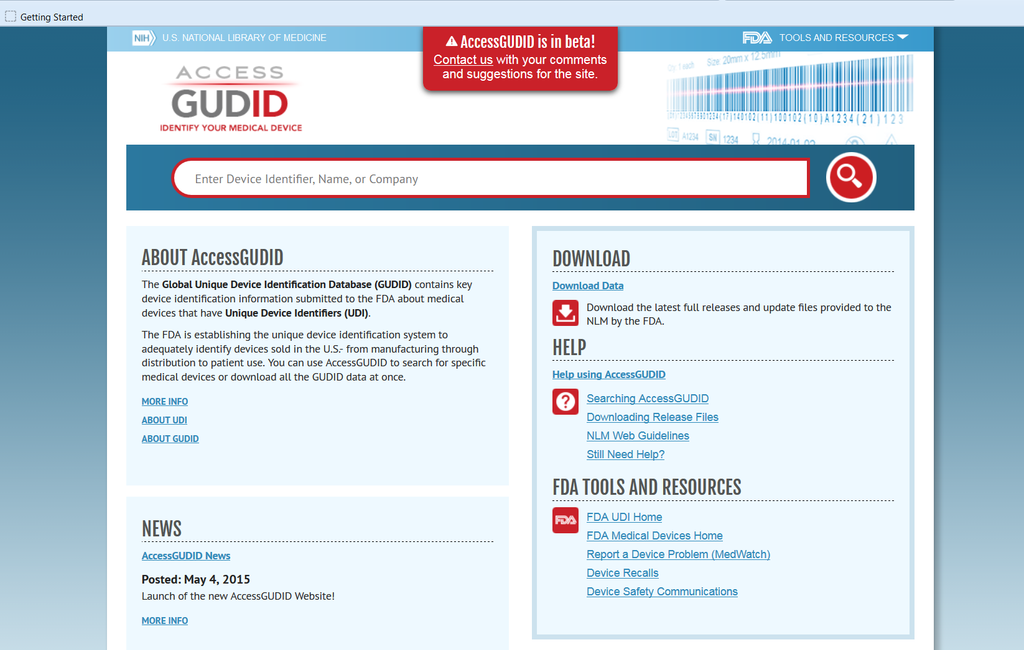
New NLM-FDA Medical Device Resource
Notes:
New NLM-FDA Medical Device Resource

Slide 28
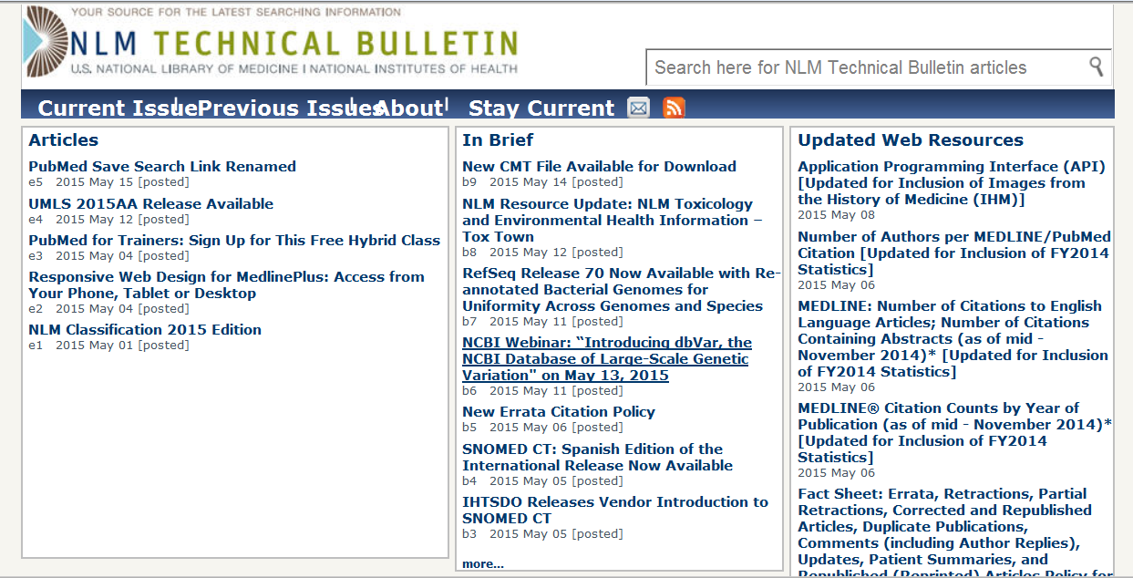
Constantly updated sources of NLM updates
Notes:
Constantly updated sources of NLM updates

Slide 29
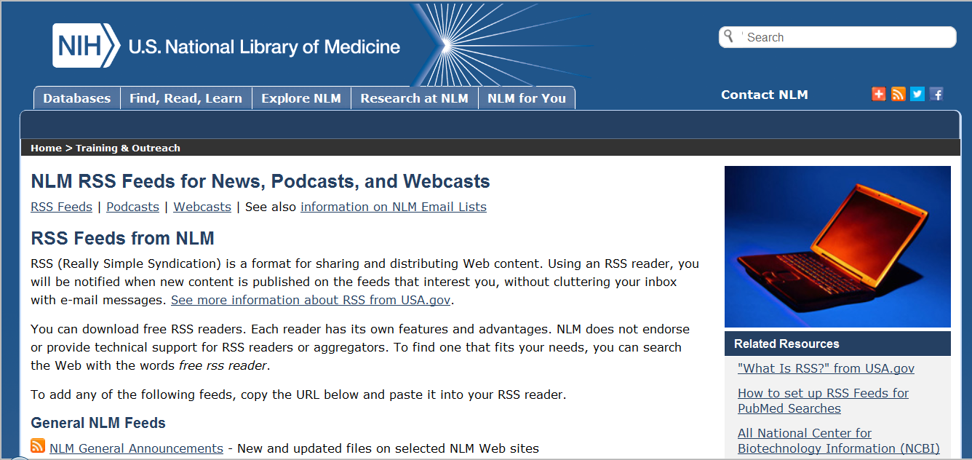
More updated sources of NLM updates
Notes:
More updated sources of NLM updates

