Slide 1
National Library of Medicine Update – Annual Meeting of the Medical Library Association
Joyce E. B. Backus
Associate Director for Library Operations
National Library of Medicine, National Institutes of Health
U.S. Department of Health and Human Services
May 19, 2015
Notes:
National Library of Medicine Update – Annual Meeting of the Medical Library Association
Joyce E. B. Backus
Associate Director for Library Operations
National Library of Medicine, National Institutes of Health
U.S. Department of Health and Human Services
May 19, 2015

Slide 2
Today’s Topics
Responding to Needs
Resource Sharing
MEDLINE, PubMed and PMC
Metadata, Data and MeSH
Responsive Web Design
Learning Resource Database
National Network of Libraries of Medicine
Collections and Exhibitions Come to You
Staff News
Keep in Touch!
Notes:
Today’s Topics
Responding to Needs
Resource Sharing
MEDLINE, PubMed and PMC
Metadata, Data and MeSH
Responsive Web Design
Learning Resource Database
National Network of Libraries of Medicine
Collections and Exhibitions Come to You
Staff News
Keep in Touch!

Slide 3
Responding to Needs
Notes:
Responding to Needs

Slide 4

Emergency Access Initiative - EAI
Collaborative partnership between NLM and participating publishers to provide free access to full-text articles from over 700 biomedical serial titles, over 4,000 books, and 6 point-of-care tools to healthcare professionals and libraries affected by disasters in the United States and internationally
Omar Havana / Getty Images
Notes:
Emergency Access Initiative
EAICollaborative partnership between NLM and participating publishers to provide free access to full-text articles from over 700 biomedical serial titles, over 4,000 books, and 6 point-of-care tools to healthcare professionals and libraries affected by disasters in the United States and internationally

Slide 5
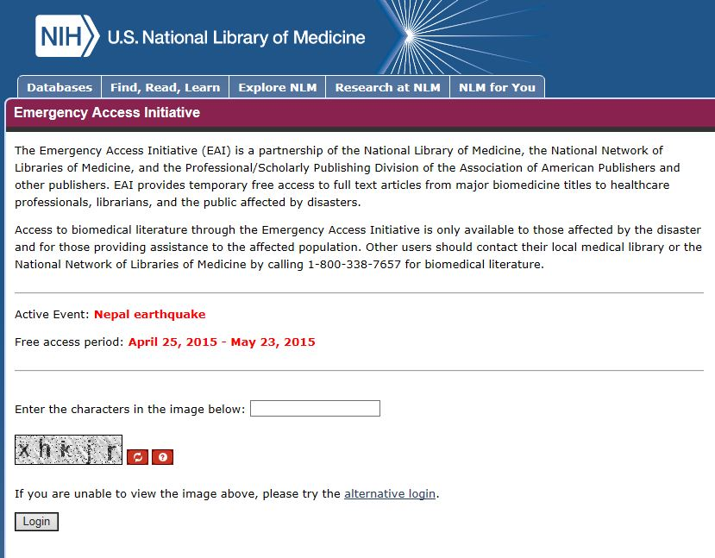
EAI Login Page - Active
http://eai.nlm.nih.gov
Notes:
EAI Login Page - Active

Slide 6
Sample Journal & Book Titles
Accident and emergency nursing
American journal of infection control
Cochrane database of systematic reviews
Depression and anxiety
Emergency radiology
Environmental toxicology and pharmacology
International journal of cardiology
Journal of anxiety disorders
Journal of emergency medicine
Journal of traumatic stress
New England journal of medicine
Merck manual of diagnosis and therapy
Public health and prevention management
Trauma
Human virology
Emergency medicine procedures
Infectious diseases: the clinician’s guide to diagnosis, treatment and prevention
AHFS Drug Information
Red Book : Report of the Committee on Infectious Diseases
Notes:
Sample
Accident and emergency nursing
American journal of infection control
Cochrane database of systematic reviews
Depression and anxiety
Emergency radiology
Environmental toxicology and pharmacology
International journal of cardiology
Journal of anxiety disorders
Journal of emergency medicine
Journal of traumatic stress
New England journal of medicine
e Journal & Book Titles
Merck manual of diagnosis and therapy
Public health and prevention management
Trauma
Human virology
Emergency medicine procedures
Infectious diseases: the clinician’s guide to diagnosis, treatment and prevention
AHFS Drug Information
Red Book : Report of the Committee on Infectious Diseases

Slide 7
Thanks to Participating Publishers
American Academy of Pediatrics
American Association for the Advancement of Science
American Chemical Society
American College of Physicians
American Society of Health-Systems Pharmacists
American Society for Microbiology Press
B.C. Decker
BMJ
Cambridge University Press
EBSCO
Elsevier
F.A. Davis
Mary Ann Liebert
Massachusetts Medical Society
McGraw-Hill
Merck Publishing
Oxford University Press
People’s Medical Publishing House
Rittenhouse
Springer
University of Chicago Press
Wiley
Wolters Kluwer
Notes:
Thanks to Participating Publishers
American Academy of Pediatrics
American Association for the Advancement of Science
American Chemical Society
American College of Physicians
American Society of Health-Systems Pharmacists
American Society for Microbiology Press
B.C. Decker
BMJ
Cambridge University Press
EBSCO
Elsevier
F.A. Davis
Mary Ann Liebert
Massachusetts Medical Society
McGraw-Hill
Merck Publishing
Oxford University Press
People’s Medical Publishing House
Rittenhouse
Springer
University of Chicago Press
Wiley
Wolters Kluwer

Slide 8
Emergency Access Initiative Activations
Haiti – earthquake (2010)
Pakistan – flooding (2010)
Haiti – cholera (2010)
Japan – earthquake, tsunami, nuclear (2011)
Philippines – super typhoon (2013)
Ebola (2014)
  August 12, 2014 – December 12, 2014
Nepal – earthquake
  April 26, 2015 -
Notes:
Emergency Access Initiative Activations
Haiti – earthquake (2010)
Pakistan – flooding (2010)
Haiti – cholera (2010)
Japan – earthquake, tsunami, nuclear (2011)
Philippines – super typhoon (2013)
Ebola (2014)
August 12, 2014 – December 12, 2014
Nepal – earthquake
April 26, 2015 -

Slide 9













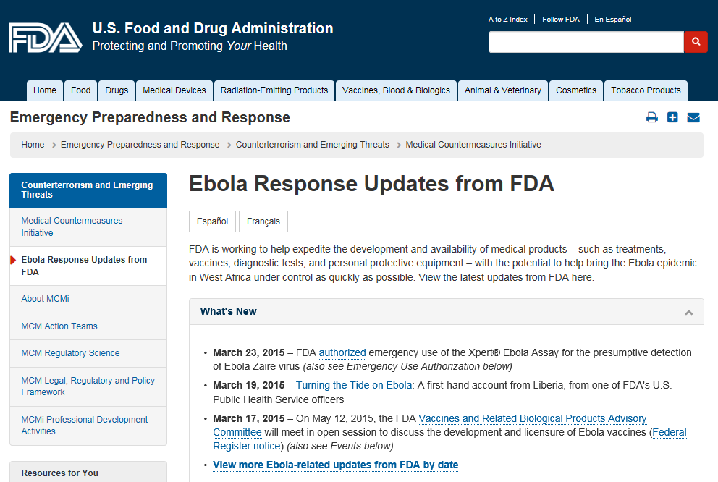



Who is Producing Ebola Information?
Notes:
Who is Producing Ebola Information?
American College of Emergency Physicians
United Nations Office for the Coordination of Humanitarian Affairs
Center for Disease Control
European Centre for Disease Prevention and Control
Doctors Without Borders
U.S. Food and Drug Administration
American Hospital Association
World Health Organization
United States Environmental Protection Agency
National Institutes of Health
SAMHSA
IDSA
United States Department of Transportation
NACCHO
U.S. Army

Slide 10
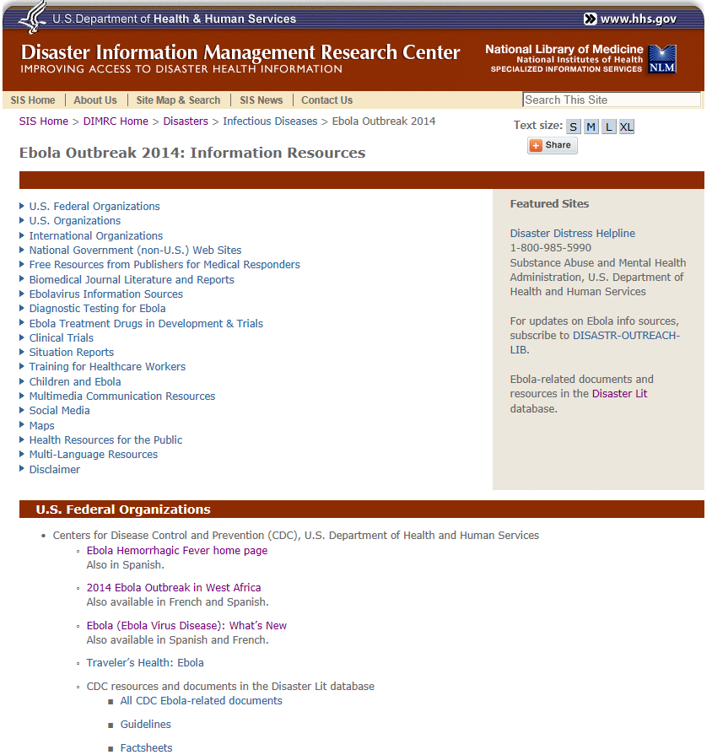
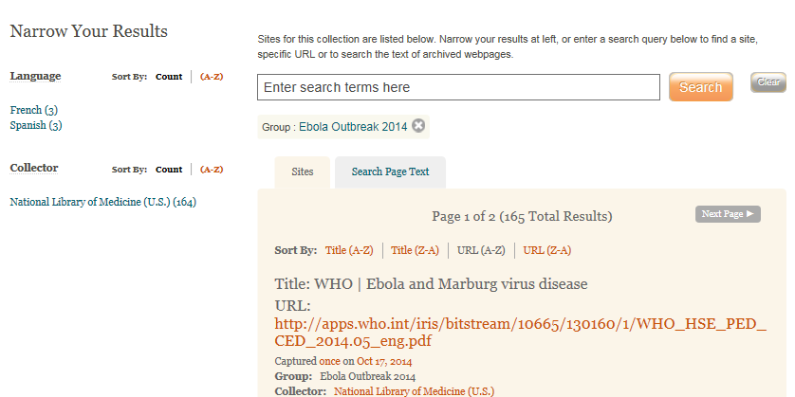
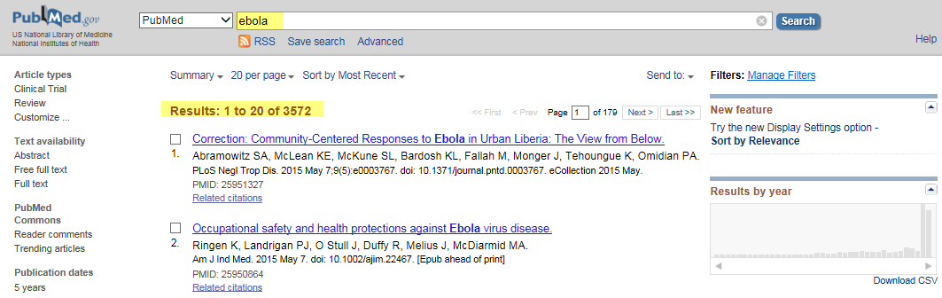
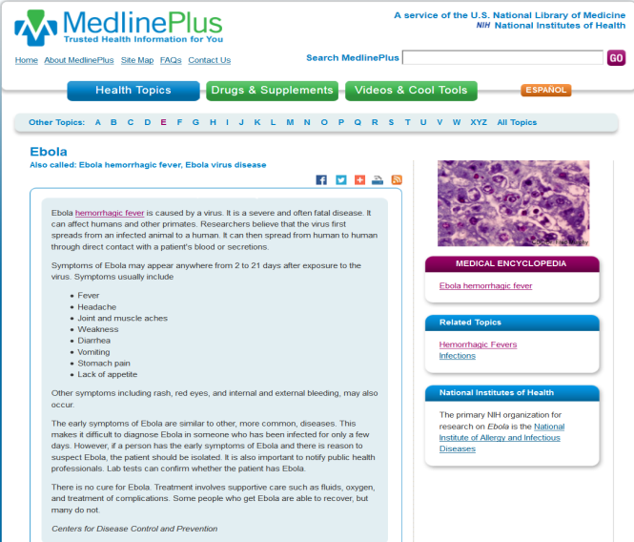
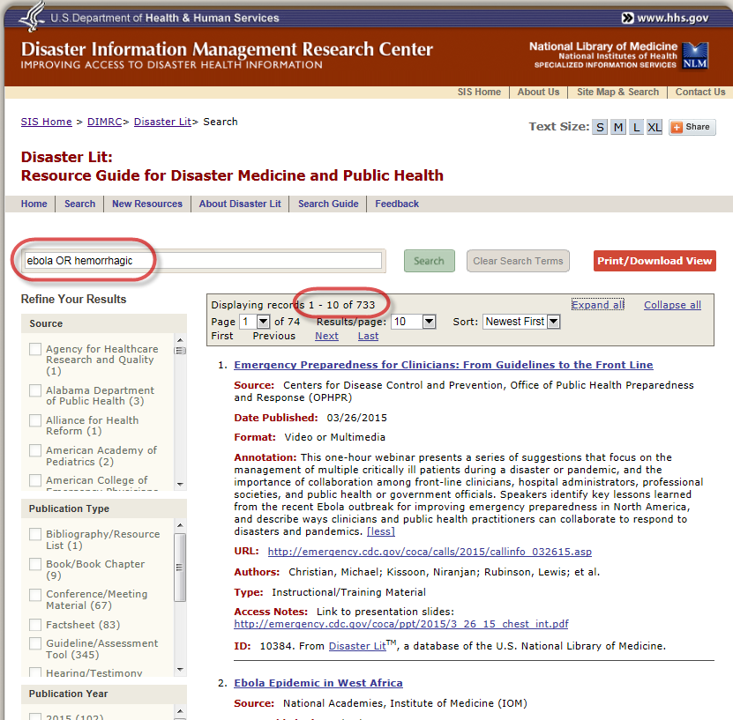
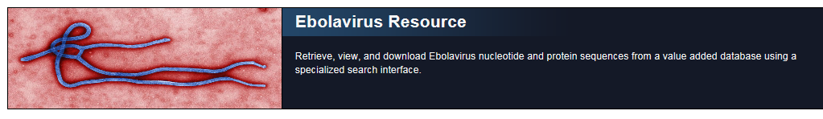
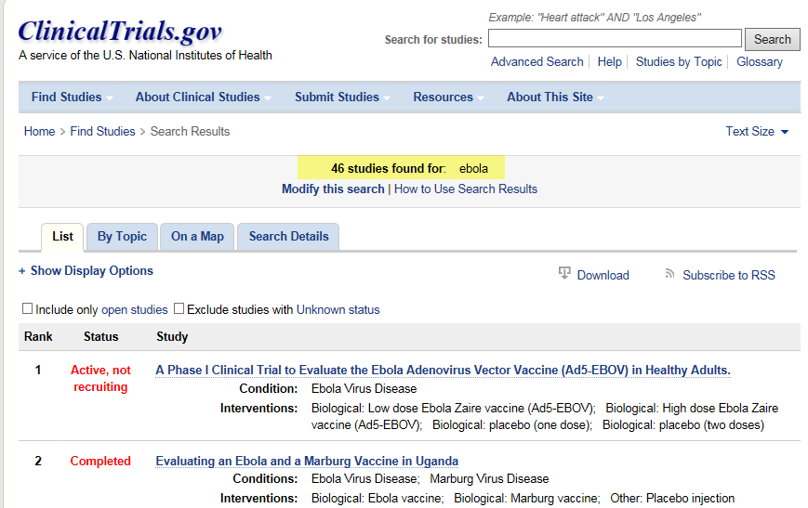
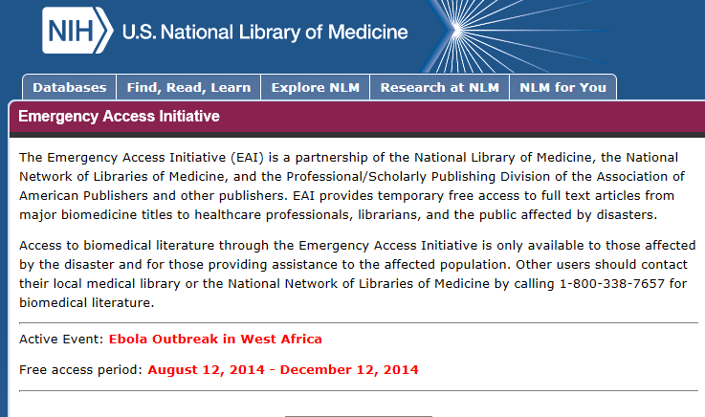
NLM Resources on Ebola
Notes:
NLM Resources on Ebola
Disaster Information Management Research Center
MedlinePlus
ClinicalTrials.gov
PubMed

Slide 11
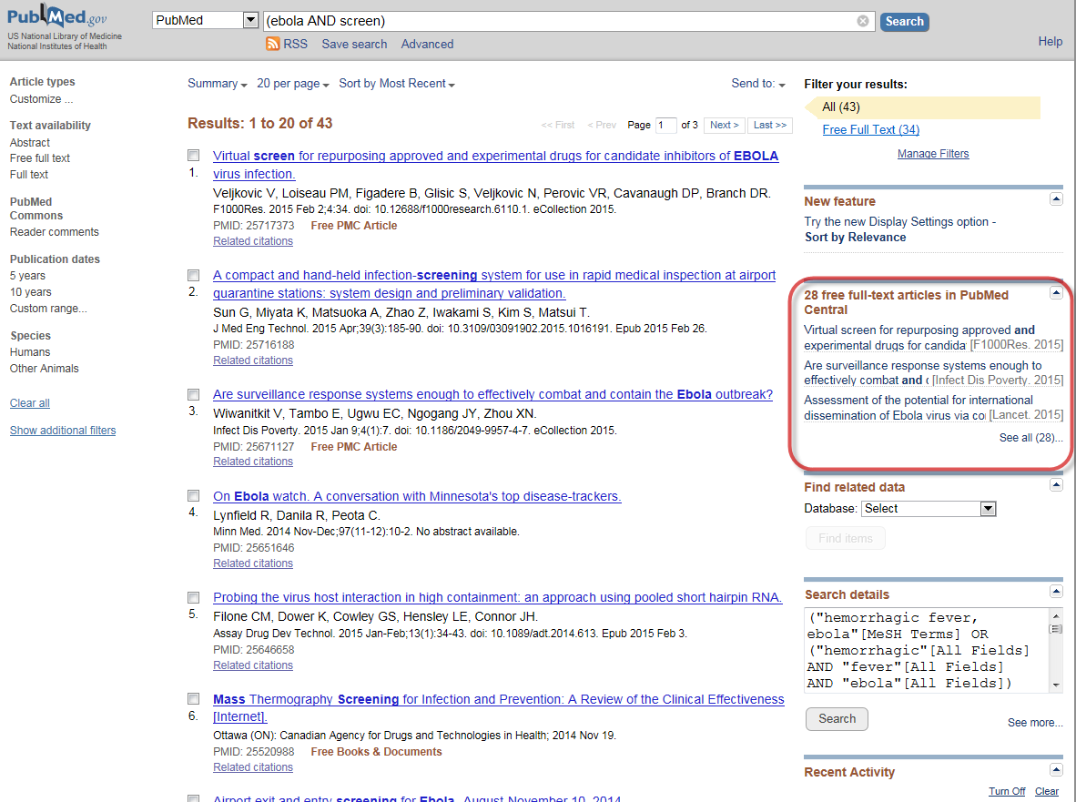
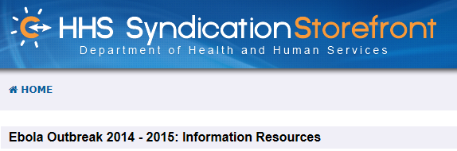
Managing Ebola Information
Managing Ebola Information
Notes:
Managing Ebola Information
Disaster Information Management Research Center
HHS Syndication Storefront

Slide 12
Disaster Outreach Collaboration Projects
Please consider applying:
Funding solicitation now open for libraries and disaster/emergency organizations to conduct projects to improve access to disaster medicine and public health information
Applications due July 6, 2015 at noon
$15,000 - $30,000 for one year
2015 disaster outreach
Notes:
Disaster Outreach Collaboration Projects
Please consider applying:
Funding solicitation now open for libraries and disaster/emergency organizations to conduct projects to improve access to disaster medicine and public health information
Applications due July 6, 2015 at noon
$15,000 - $30,000 for one year
2015 disaster outreach

Slide 13
2014 Disaster Outreach Collaboration Projects
Idaho State University
  Development of Disaster Health Information Training Program for Hospital Emergency Preparedness Professionals
Indiana State University, Cunningham Memorial Library:
  Integrating Librarians into Local Disaster Management and Training
University of Washington Health Sciences Library
  RRAIN Washington - Response and Recovery App in Washington
Elkhart General Hospital Medical Library
  Preparing your Go-Bag for Disaster-related Information Needs
Notes:
2014 Disaster Outreach Collaboration Projects
Idaho State University
Development of Disaster Health Information Training Program for Hospital Emergency Preparedness Professionals
Indiana State University, Cunningham Memorial Library:
Integrating Librarians into Local Disaster Management and Training
University of Washington Health Sciences Library
RRAIN Washington - Response and Recovery App in Washington
Elkhart General Hospital Medical Library
Preparing your Go-Bag for Disaster-related Information Needs

Slide 14
Resource Sharing
Notes:
Resource Sharing

Slide 15
ILL Requests in DOCLINE
58% decline since 2002
Notes:
ILL Requests in DOCLINE from 1994 0 2014

Slide 16
Future of Resource Sharing
What we learned
  Increasing availability of free full-text & changing patron behavior is decreasing ILL overall
  E-journals pose challenges for ILL (embargos, negotiation)
  41% of health science libraries are staffed by 1 person
DOCLINE changes
  Check embargo periods during request routing (Done)
  Specify days of the week library provides ILL (Coming …)
  Eliminate daily login requirement (Coming …)
Notes:
Future of Resource Sharing
What we learned
Increasing availability of free full-text & changing patron behavior is decreasing ILL overall
E-journals pose challenges for ILL (embargos, negotiation)
41% of health science libraries are staffed by 1 person
DOCLINE changes
Check embargo periods during request routing (Done)
Specify days of the week library provides ILL (Coming …)
Eliminate daily login requirement (Coming …)

Slide 17
Future of Resource Sharing
We’re exploring
Changing DOCLINE membership requirements
Improving DOCLINE interoperability with other ILL Systems: OCLC, ILLiad, Relais and Clio
Thanks to
Fred King (MedStar Health)
Robb Mackes (Health Sciences Library Association of New Jersey)
PJ Grier (Southeastern Atlantic RML)
Ashley Cuffia (Southeastern Atlantic RML)
Notes:
Future of Resource Sharing
We’re exploring
Changing DOCLINE membership requirements
Improving DOCLINE interoperability with other ILL Systems: OCLC, ILLiad, Relais and Clio
Thanks to
Fred King (MedStar Health)
Robb Mackes (Health Sciences Library Association of New Jersey)
PJ Grier (Southeastern Atlantic RML)
Ashley Cuffia (Southeastern Atlantic RML)

Slide 18
MEDLINE, PubMed, PMC
Notes:
MEDLINE, PubMed, PMC

Slide 19


Who decides what’s in MEDLINE?
Literature Selection Technical Review Committee (LSTRC)
CABELLO, Felipe C., M.D., New York Medical College, Valhalla, NY
CHEUNG, Dorothy, M.D., Allergy-Immunology Medical College of Wisconsin, Milwaukee, WI
CORSI, Karen F., Sc.D., University of Colorado, Denver, CO
CRUMMETT, Courtney, M.L.S., M.S, MIT Libraries, Cambridge, MA
DELCLOS, George L., M.D., Ph.D., University of Texas-Houston, Houston, TX
GWINN, Marta, M.D., M.P.H, Centers for Disease Control and Prevention, Atlanta, GA
JOE, Jennie R., Ph.D., M.P.H., M.A., University of Arizona College of Medicine, Tucson, AZ
NGUYEN, Thu, Annelise, Ph.D., M.B.A., Kansas State University, Manhattan, KS
NWOMEH, Benedict C., M.D., Nationwide Children's Hospital, Columbia, OH
PASCOE, John M., M.D., M.P.H., The Children's Medical Center of Dayton, Dayton, OH
PASCOE, John R., BVSc, Ph.D., University of California, Davis, CA
RAO, Jaya, M.D., American College of Physicians, Philadelphia, PA
TANNERY, Nancy, H., M.L.S., University of Pittsburgh, Pittsburgh, PA
YSHIMURA, Masami, D.Sc., Louisiana State University, Baton Rouge, LA
Notes:
Who decides what’s in MEDLINE?
Literature Selection Technical Review Committee (LSTRC)
CABELLO, Felipe C., M.D., New York Medical College, Valhalla, NY
CHEUNG, Dorothy, M.D., Allergy-Immunology Medical College of Wisconsin, Milwaukee, WI
CORSI, Karen F., Sc.D., University of Colorado, Denver, CO
CRUMMETT, Courtney, M.L.S., M.S, MIT Libraries, Cambridge, MA
DELCLOS, George L., M.D., Ph.D., University of Texas-Houston, Houston, TX
GWINN, Marta, M.D., M.P.H, Centers for Disease Control and Prevention, Atlanta, GA
JOE, Jennie R., Ph.D., M.P.H., M.A., University of Arizona College of Medicine, Tucson, AZ
NGUYEN, Thu, Annelise, Ph.D., M.B.A., Kansas State University, Manhattan, KS
NWOMEH, Benedict C., M.D., Nationwide Children's Hospital, Columbia, OH
PASCOE, John M., M.D., M.P.H., The Children's Medical Center of Dayton, Dayton, OH
PASCOE, John R., BVSc, Ph.D., University of California, Davis, CA
RAO, Jaya, M.D., American College of Physicians, Philadelphia, PA
TANNERY, Nancy, H., M.L.S., University of Pittsburgh, Pittsburgh, PA
YSHIMURA, Masami, D.Sc., Louisiana State University, Baton Rouge, LA

Slide 20
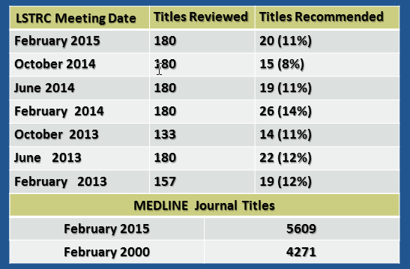
Journal Titles Recommended by LSTRC
Notes:
Journal Titles Recommended by LSTRC
LSTRC Meeting Date: February 2015
Titles Reviewed: 180
Titles Recommended: 20 (11%)
LSTRC Meeting Date: October 2014
Titles Reviewed: 180
Titles Recommended: 15 (8%)
LSTRC Meeting Date: June 2014
Titles Reviewed: 180
Titles Recommended: 19 (11%)
LSTRC Meeting Date: February 2014
Titles Reviewed: 180
Titles Recommended: 26 (14%)
LSTRC Meeting Date: October 2013
Titles Reviewed: 133
Titles Recommended: 14 (11%)
LSTRC Meeting Date: June 2013
Titles Reviewed: 180
Titles Recommended: 22 (12%)
LSTRC Meeting Date: February 2013
Titles Reviewed: 157
Titles Recommended: 19 (12%)
MEDLINE Journal Titles
February 2015 - 5609
February 2000 - 4271

Slide 21
LSTRC February 2015
180 Titles Reviewed, 20 Recommended
Country | Rev | Rec
Argentina
Australia | 1 | 1
Austria | 1
Bangladesh | 1
Belgium | 1
Bosnia Herzegov
Brazil | 3 | 1
Bulgaria | 1
Canada | 2
Chile
China | 17 | 2
Colombia | 1
Czech Republic | 1
Ecuador
Egypt | 10
Finland | 1
France | 2
Germany | 6
Country | Rev | Rec
Hungary
India | 16 | 1
Iran | 2 | 1
Iraq
Italy | 6
Japan | 2
Kenya
Korea | 6 | 1
Macedonia | 1
Malaysia | 1
Malta
Nepal | 1
Netherlands | 3 | 1
Pakistan
Peru
Poland | 3
Portugal | 1
Romania | 3
Country | Rev | Rec
Russia | 2
Serbia
Singapore | 1
Slovakia | 1
Slovenia
South Africa | 2
Spain | 5
Sri Lanka | 1
Switzerland | 1
Trinidad Tobago | 1
Turkey | 8
U Arab Emirates
Ukraine
United Kingdom | 19 | 3
United States | 45 | 9
Vietnam | 1
Notes:
LSTRC February 2015
180 Titles Reviewed, 20 Recommended
Country: Argentina
Reviewed:
Recommended:
Country: Australia
Reviewed: 1
Recommended: 1
Country: Austria
Reviewed: 1
Recommended:
Country: Bangladesh
Reviewed: 1
Recommended:
Country: Belgium
Reviewed: 1
Recommended:
Country: Bosnia Herzegov
Reviewed:
Recommended:
Country: Brazil
Reviewed: 3
Recommended: 1
Country: Bulgaria
Reviewed: 1
Recommended:
Country: Canada
Reviewed: 2
Recommended:
Country: Chile
Reviewed:
Recommended:
Country: China
Reviewed: 17
Recommended: 2
Country: Colombia
Reviewed: 1
Recommended:
Country: Czech Republic
Reviewed: 1
Recommended:
Country: Ecuador
Reviewed:
Recommended:
Country: Egypt
Reviewed: 10
Recommended:
Country: Finland
Reviewed: 1
Recommended:
Country: France
Reviewed: 2
Recommended:
Country: Germany
Reviewed: 6
Recommended:
Country: Hungary
Reviewed:
Recommended:
Country: India
Reviewed: 16
Recommended: 1
Country: Iran
Reviewed: 2
Recommended: 1
Country: Iraq
Reviewed:
Recommended:
Country: Italy
Reviewed: 6
Recommended:
Country: Japan
Reviewed: 2
Recommended:
Country: Kenya
Reviewed:
Recommended:
Country: Korea
Reviewed: 6
Recommended: 1
Country: Macedonia
Reviewed: 1
Recommended:
Country: Malaysia
Reviewed: 1
Recommended:
Country: Malta
Reviewed:
Recommended:
Country: Nepal
Reviewed: 1
Recommended:
Country: Netherlands
Reviewed: 3
Recommended: 1
Country: Pakistan
Reviewed:
Recommended:
Country: Peru
Reviewed:
Recommended:
Country: Poland
Reviewed: 3
Recommended:
Country: Portugal
Reviewed: 1
Recommended:
Country: Romania
Reviewed: 3
Recommended:
Country: Russia
Reviewed: 2
Recommended:
Country: Serbia
Reviewed:
Recommended:
Country: Singapore
Reviewed: 1
Recommended:
Country: Slovakia
Reviewed: 1
Recommended:
Country: Slovenia
Reviewed:
Recommended:
Country: South Africa
Reviewed: 2
Recommended:
Country: Spain
Reviewed: 5
Recommended:
Country: Sri Lanka
Reviewed: 1
Recommended:
Country: Switzerland
Reviewed: 1
Recommended:
Country: Trinidad Tobago
Reviewed: 1
Recommended:
Country: Turkey
Reviewed: 8
Recommended:
Country: U Arab Emirates
Reviewed: 1
Recommended:
Country: Ukraine
Reviewed:
Recommended:
Country: United Kingdom
Reviewed: 19
Recommended: 3
Country: United States
Reviewed: 45
Recommended: 9
Country: Vietnam
Reviewed: 1
Recommended:

Slide 22
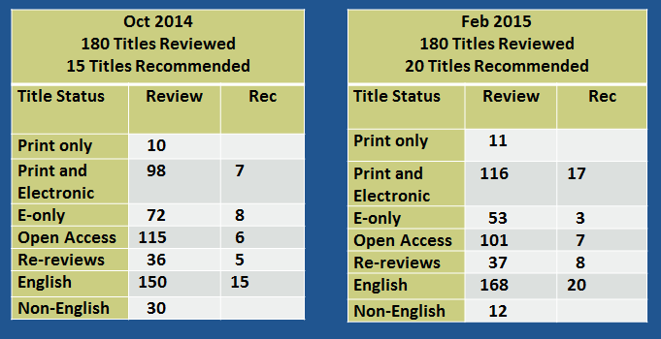
LSTRC October 2014 and February 2015
Titles Reviewed and Recommended by Title Status
Notes:
LSTRC October 2014 and February 2015
Titles Reviewed and Recommended by Title Status
Oct 2014
180 Titles Reviewed
15 Titles Recommended
Title Status: Print only
Review: 10
Rec: n/a
Title Status: Print and Electronic
Review: 98
Rec: 7
Title Status: E-only
Review: 72
Rec: 8
Title Status: Open Access
Review: 115
Rec: 6
Title Status: Re-reviews
Review: 36
Rec: 5
Title Status: English
Review: 150
Rec: 15
Title Status: Non-English
Review: 30
Rec: n/a
LSTRC October 2014 and February 2015
Titles Reviewed and Recommended by Title Status
Feb 2015
180 Titles Reviewed
20 Titles Recommended
Title Status: Print only
Review: 11
Rec: n/a
Title Status: Print and Electronic
Review: 116
Rec: 17
Title Status: E-only
Review: 53
Rec: 3
Title Status: Open Access
Review: 101
Rec: 7
Title Status: Re-reviews
Review: 37
Rec: 8
Title Status: English
Review: 168
Rec: 20
Title Status: Non-English
Review: 12
Rec: n/a

Slide 23
PubMed Full Text Links
 | Total Citations | # Linked to Full text | % Linked to Full Text | # Linked to Free Full Text | % Linked to Free Full Text
All PubMed | 24,868,211 | 15,046,316 | 61% | 4,895,190 | 20%
1990 - present | 15,932,283 | 12,526,484 | 79% | 3,904,982 | 25%
2000 - present | 11,522,976 | 10,192,479 | 88% | 3,250,942 | 28%
2010 - present | 5,126,154 | 4,793,288 | 94% | 1,708,483 | 33%
Notes:
PubMed Full Text Links
2010 – present: 94% linked to Full Text, 33%% Linked to Free Full Text

Slide 24
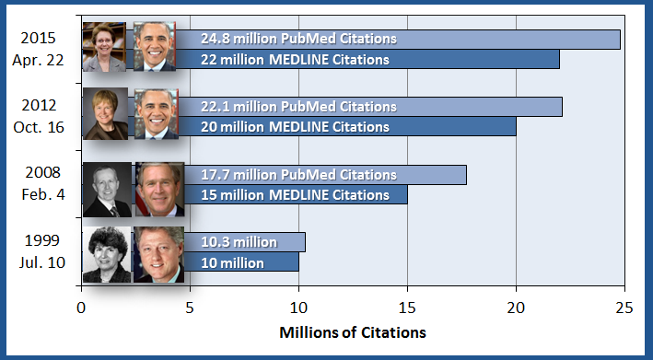
MEDLINE and PubMed Milestones
Notes:
MEDLINE and PubMed Milestones
April 22, 2015
MEDLINE and PubMed Milestones
MEDLINE and PubMed Milestones
October 16, 2012
22.1 million PubMed Citations
20 million MEDLINE Citations
February 2, 2008
17.7 million PubMed Citations
15 million MEDLINE Citations
July 10, 1999
10.3 million
10 million

Slide 25
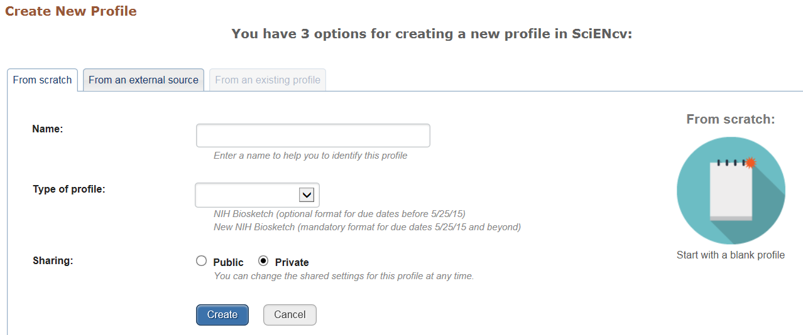
SciENcv Updates
Notes:
SciENcv Updates

Slide 26
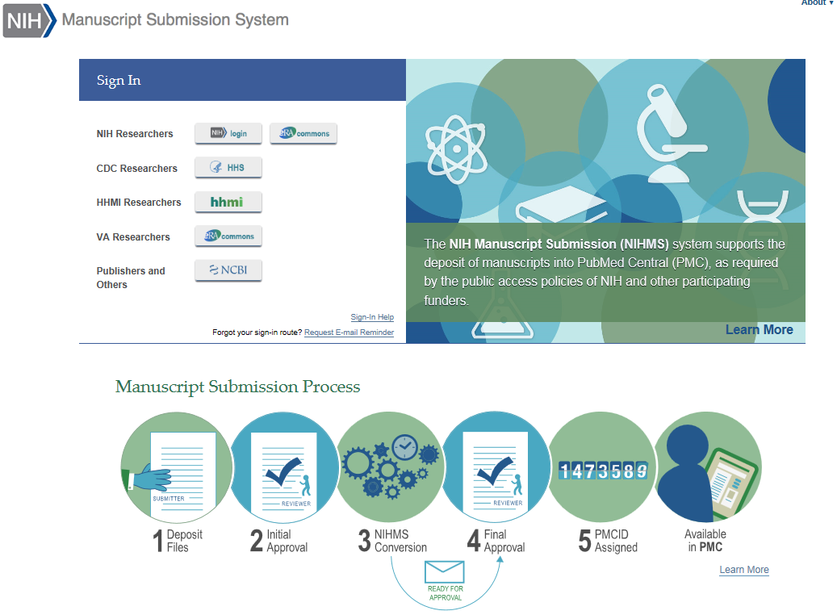
NIH Manuscript Submission System –
New Look
Notes:
NIH Manuscript Submission System has a New Look

Slide 27
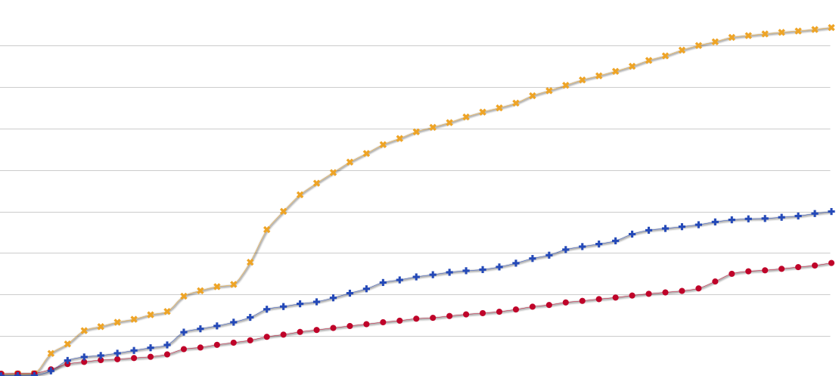
PubMed Commons:
A forum for scientific discussion on PubMed
Pilot began - October 22, 2013
Comments visible to the public - December 19, 2013
Sustainable infrastructure that minimizes potentially harmful use of the forum
Quality of the comments is high – use of the Commons is low
Members
Spring 2015
Approaching 9,000 members
~3,000 comments
Dec
2013
Oct
2013
Ratings
Comments
Notes:
PubMed Commons: A forum for scientific discussion on PubMed
Pilot began - October 22, 2013
Comments visible to the public - December 19, 2013
Sustainable infrastructure that minimizes potentially harmful use of the forum
Quality of the comments is high – use of the Commons is low

Slide 28

Commons Journal Clubs
New for 2015 – Journal Club membership of PubMed Commons, with 2 PubMed Commons member guarantors
Journal clubs bring in-depth group discussions of articles to PubMed users
Clubs get their own profile page on PubMed
There are now 15 journal clubs in the Commons
Consider leading one
Notes:
PubMed Commons Journal Clubs
New for 2015 – Journal Club membership of PubMed Commons, with 2 PubMed Commons member guarantors
Journal clubs bring in-depth group discussions of articles to PubMed users
Clubs get their own profile page on PubMed
There are now 15 journal clubs in the Commons
Consider leading one

Slide 29

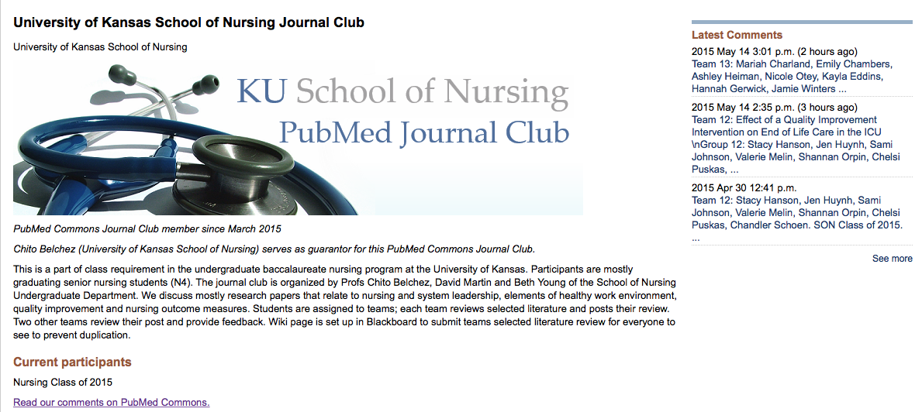
KU school of Nursing PubMed Journal
Notes:
PubMed Commons University of Kansas School of Nursing Journal Club

Slide 30
Metadata, Data and MeSH
Notes:
Metadata, Data and MeSH

Slide 31






Bibliographic Framework Initiative or
BIBFRAME (BF) at NLM, Phase 2
Goal: Replace the MARC format and increase the exposure, sharing and interoperability of library data to facilitate discovery and linking
NLM experimenting with a modular BF approach
  Develop a core BF vocabulary that can be extended with data elements or properties from existing descriptive metadata schema. E.g., RDA, MODS, EAD, Dublin Core
Notes:
Bibliographic Framework Initiative or
BIBFRAME (BF) at NLM, Phase 2
Goal: Replace the MARC format and increase the exposure, sharing and interoperability of library data to facilitate discovery and linking
NLM experimenting with a modular BF approach
Develop a core BF vocabulary that can be extended with data elements or properties from existing descriptive metadata schema. E.g., RDA, MODS, EAD, Dublin Core

Slide 32
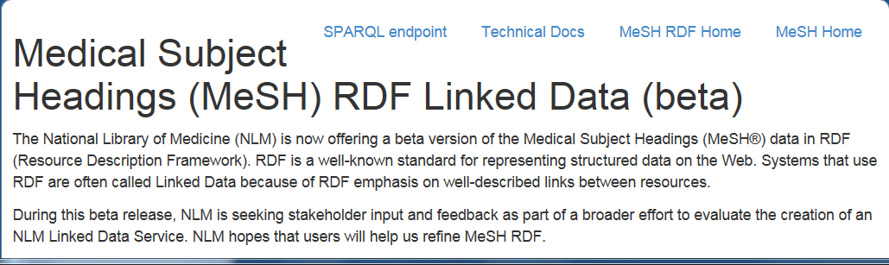
Linked Data at NLM
Linked Data at NLM: Environmental Scan, NLM Data Survey and Next Steps
Current activities: MeSH RDF, PubChem RDF and BIBFRAME
An authoritative representation of MeSH RDF
  http://id.nlm.nih.gov/mesh/
Notes:
Linked Data at NLM
Linked Data at NLM: Environmental Scan, NLM Data Survey and Next Steps
Current activities: MeSH RDF, PubChem RDF and BIBFRAME
An authoritative representation of MeSH RDF
http://id.nlm.nih.gov/mesh/

Slide 33
Responsive Web Design
Notes:
Responsive Web Design

Slide 34

Responsive Web Design
Flexible, grid-based layout that responds to screen size in delivering content
Notes:
Responsive Web Design
Flexible, grid-based layout that responds to screen size in delivering content

Slide 35

Mobile Features
Text is readable without zooming
Drop-down and expand-collapse buttons for compact display
Links are spaced for easy tapping

Slide 36
Referrals to MedlinePlus
6 Months Before Responsive
(October 22)
6 Months After Responsive
(October 22)
Notes:
Referrals to MedlinePlus (mobile)

Slide 37

Responsive Design
Notes:
AIDSinfo Responsive Design

Slide 38
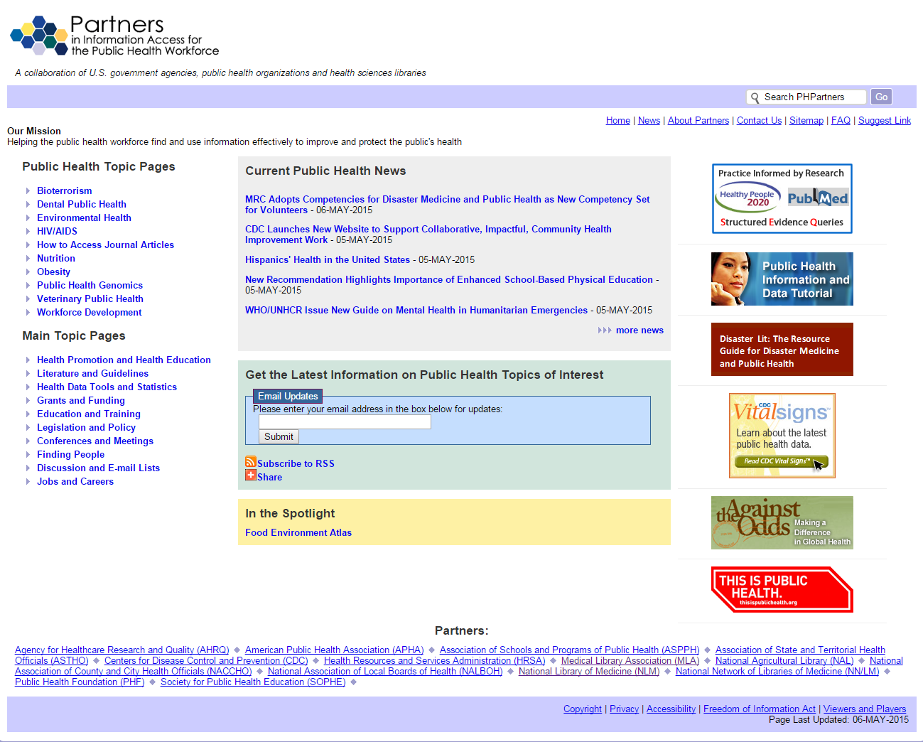
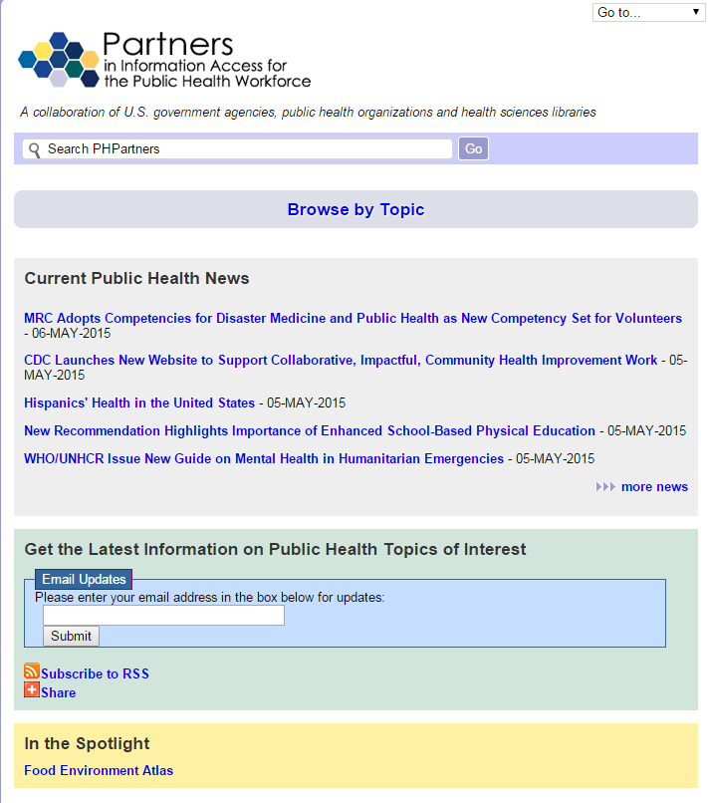
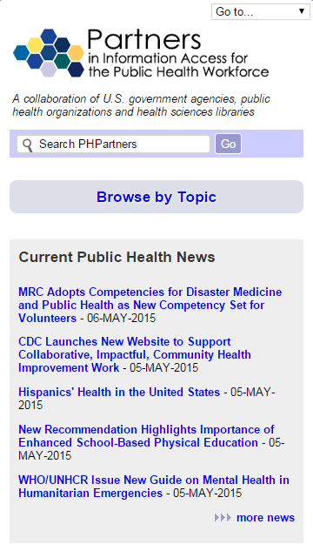
Responsive at NLM
Notes:
Partners in Information Access for the Public Health Workforce responsive design

Slide 39

Responsive Versions of DailyMed
Notes:
DailyMed responsive design

Slide 40

PubMed Mobile
Notes:
PubMed Mobile

Slide 41
Learning Resource Database
Notes:
Learning Resource Database

Slide 42
Tutorials (to-be) available through NLM learning resources

Slide 43
learn.nlm.nih.gov
Learning Resources API (Application Programming Interface)
Tagged by subject area, such as ‘My NCBI’, ‘SNOMED CT’, etc.
One-click code snippets you can use on your website that will update to show most recent tutorials from subject areas you choose (PubMed tutorials, etc)
Searchable REST API returns information and metadata (name, format, run-time, URL, etc)
Notes:
learn.nlm.nih.gov
Learning Resources API (Application Programming Interface)
Tagged by subject area, such as ‘My NCBI’, ‘SNOMED CT’, etc.
One-click code snippets you can use on your website that will update to show most recent tutorials from subject areas you choose (PubMed tutorials, etc)
Searchable REST API returns information and metadata (name, format, run-time, URL, etc)

Slide 44
Learning Resources Database
Notes:
Learning Resources Database prototype.

Slide 45
National Network of
Libraries of Medicine (NN/LM)
Notes:
National Network of
Libraries of Medicine (NN/LM)

Slide 46
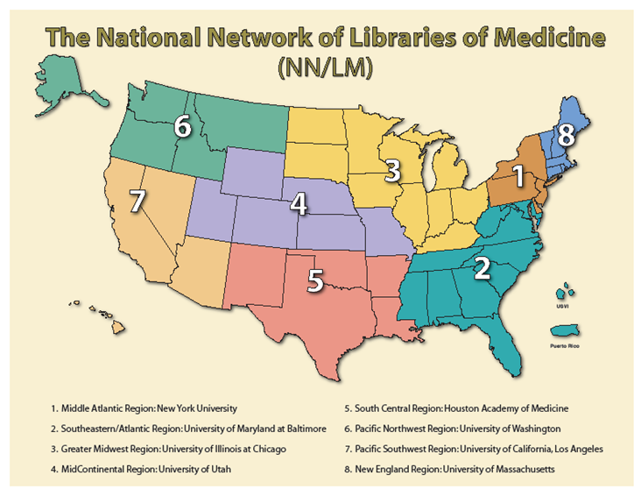
2006-2011
Notes:
2006-2011
The National Network of Libraries of Medicine Map of regions

Slide 47
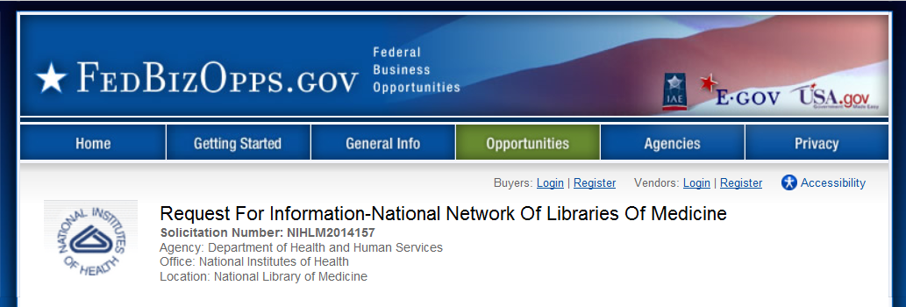
Thank you for responding!
Purpose: Seek input from current and potential user communities to maximize NN/LM effectiveness and efficiency
48 comments received= >130 pages of thoughtful suggestions
Notes:
Thank you for responding!
Purpose: Seek input from current and potential user communities to maximize NN/LM effectiveness and efficiency
48 comments received= >130 pages of thoughtful suggestions

Slide 48
Differing Opinions
  General Agreement
  National Network of Libraries of Medicine (NN/LM) is valuable
  NN/LM needs more money
  Contract restrictions have a negative impact
  Too many target populations, topic areas, tasks
  Some activities should/could be handled nationally by one RML and/or NLM
  Exhibits at local/state/regional meetings are valuable, national meetings not so much
  Should be more trans-NLM coordination
  Differing Opinions
  NN/LM mission and goals
  Regional Structure
  “Unaffiliated” health professionals
  Approach to NN/LM outreach evaluation support
  Approach to improving NN/LM technology support
  Which services could or should be centralized
  Value of emphasis on certain areas, e.g., history of medicine, disaster preparedness, e-science
Notes:
General Agreement
National Network of Libraries of Medicine (NN/LM) is valuable
NN/LM needs more money
Contract restrictions have a negative impact
Too many target populations, topic areas, tasks
Some activities should/could be handled nationally by one RML and/or NLM
Exhibits at local/state/regional meetings are valuable, national meetings not so much
Should be more trans-NLM coordination
Differing Opinions
NN/LM mission and goals
Regional Structure
“Unaffiliated” health professionals
Approach to NN/LM outreach evaluation support
Approach to improving NN/LM technology support
Which services could or should be centralized
Value of emphasis on certain areas, e.g., history of medicine, disaster preparedness, e-science

Slide 49
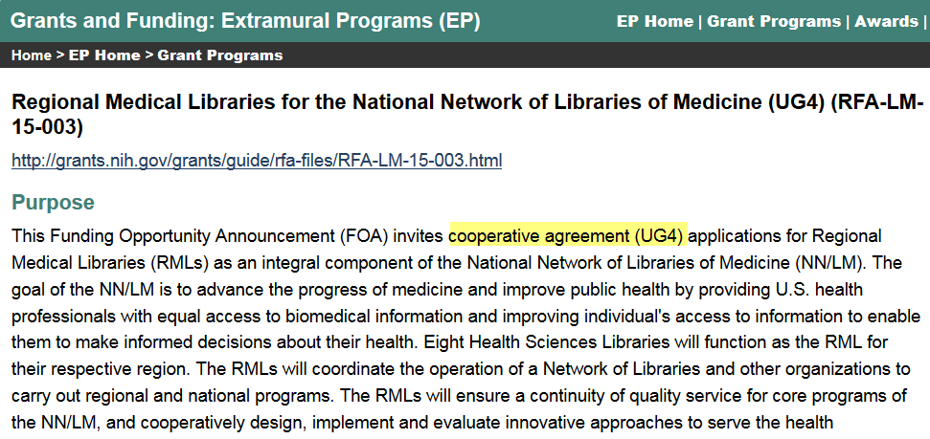
UG4 Cooperative Agreement
Notes:
UG4 Cooperative Agreement

Slide 50
Notable Changes from 2011-16
National Network Steering Committee
Focus on evaluation
Focus on collaboration
Nationalized some tasks
Name Changes: Offices + Nat’l Network Coordination Office
  Applications due July 24, 2015
  Awards begin May 2016
Notes:
Notable Changes from 2011-16
National Network Steering Committee
Focus on evaluation
Focus on collaboration
Nationalized some tasks
Name Changes: Offices + Nat’l Network Coordination Office
Applications due July 24, 2015
Awards begin May 2016

Slide 51
Collections and Exhibitions Come to You
Notes:
Collections and Exhibitions Come to You

Slide 52
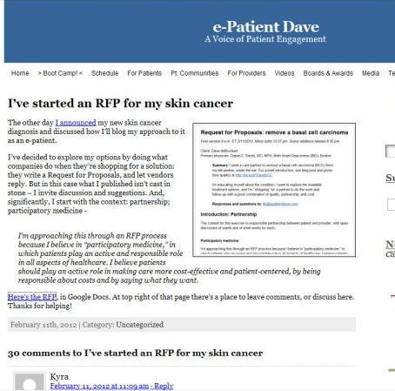
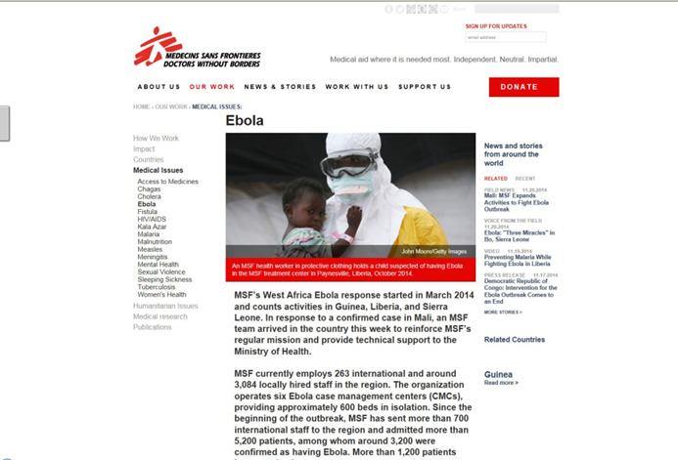
NLM Web Archive Collections
NLM institutional web content
Health and Medicine Blogs
Avian Influenza A (H7N9) Virus
Disorders of the Developing and Aging Brain: Autism and Alzheimer’s on the Web
Global Health Events (including 2014 Ebola Outbreak)
Notes:
NLM Web Archive Collections
NLM institutional web content
Health and Medicine Blogs
Avian Influenza A (H7N9) Virus
Disorders of the Developing and Aging Brain: Autism and Alzheimer’s on the Web
Global Health Events (including 2014 Ebola Outbreak)

Slide 53
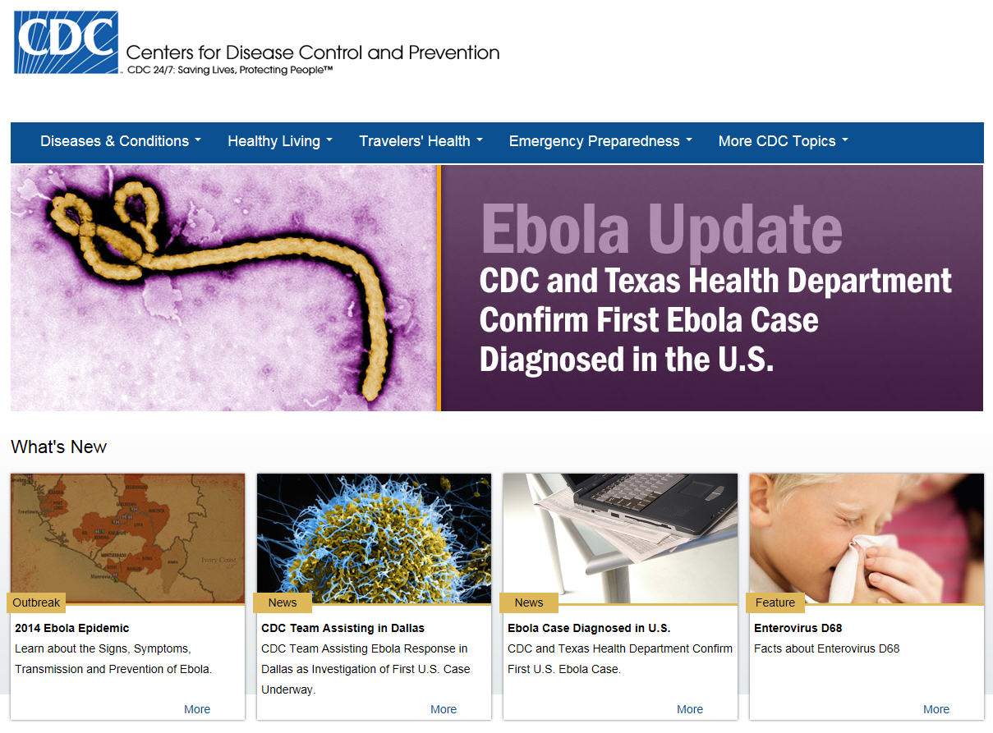

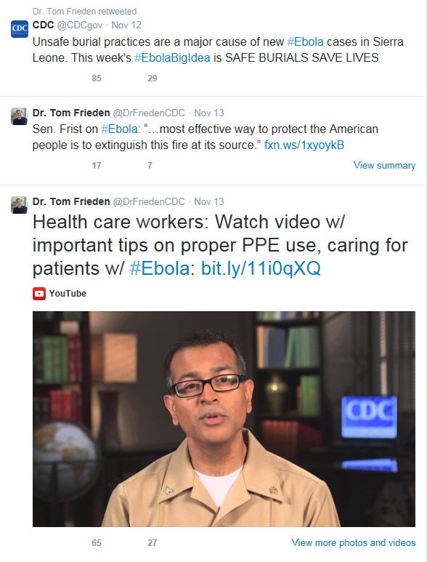

Collecting born-digital resources documenting the 2014 Ebola Outbreak
Notes:
Collecting born-digital resources documenting the 2014 Ebola Outbreak

Slide 54

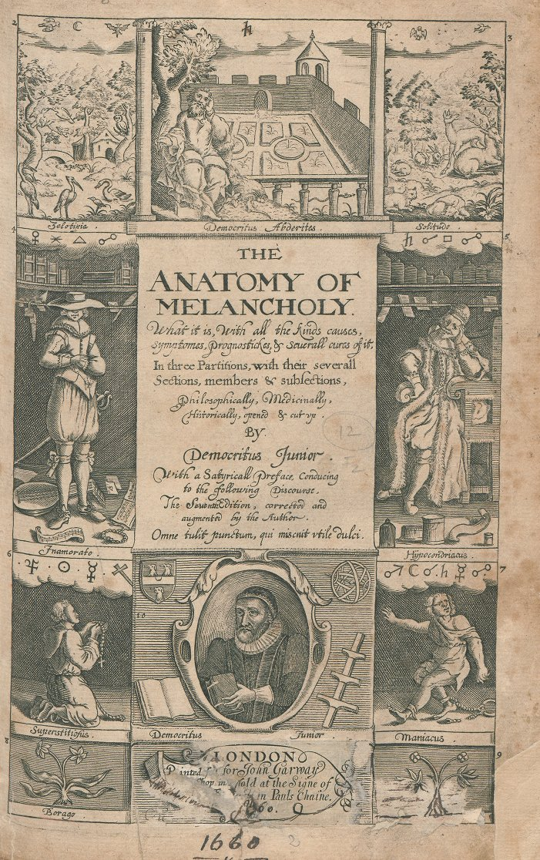

Unique 18th-century English Short Titles
Unique 18th-century English Short Titles
Notes:
Unique 18th-century English Short Titles

Slide 55
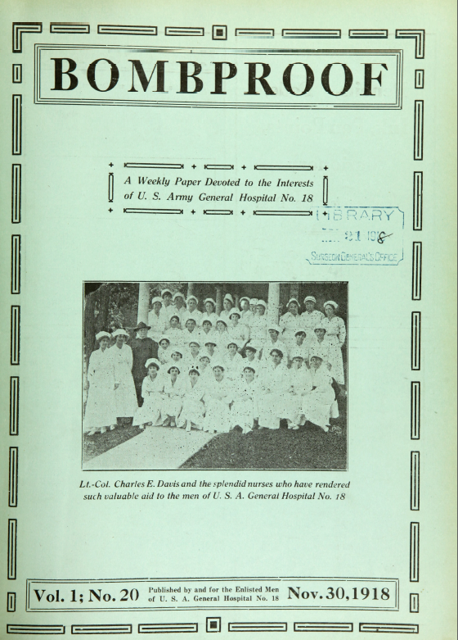

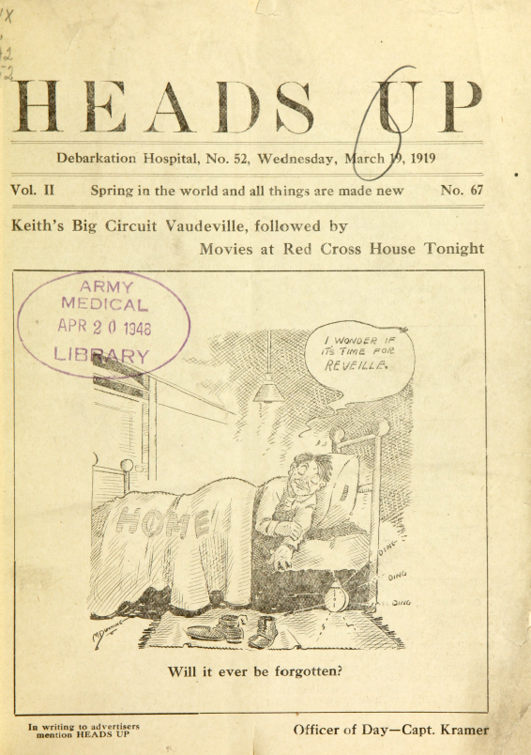
World War I Hospital Magazines
World War I Hospital Magazines
Notes:
World War I Hospital Magazines

Slide 56


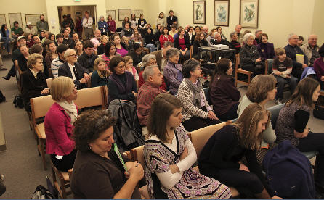
Traveling Exhibitions
Public Program Types & Numbers (n=132)
5 K-12 teachers
28 Other
21 Family programs
98 Local displays
21 Youth programs
48 Receptions
57 Lectures
Lister Hill Library of Health Sciences
University of Alabama at Birmingham
(Jan-March 2010)
Notes:
Traveling Exhibitions
Public Program Types & Numbers (n=132)
K-12 teachers: 5
Family Programs: 21
Youth Programs: 21
Receptions: 48
Lectures: 57
Local Displays: 98
Other: 28

Slide 57

Traveling Exhibitions
Notes:
Traveling Exhibitions

Slide 58
Staff News
Notes:
Staff News

Slide 59
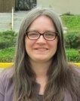
Library Operations Welcomes
Jennifer Diffin
Head, Library Technology Services Section
Technical Services Division
Notes:
Library Operations Welcomes
Jennifer Diffin
Head, Library Technology Services Section
Technical Services Division

Slide 60
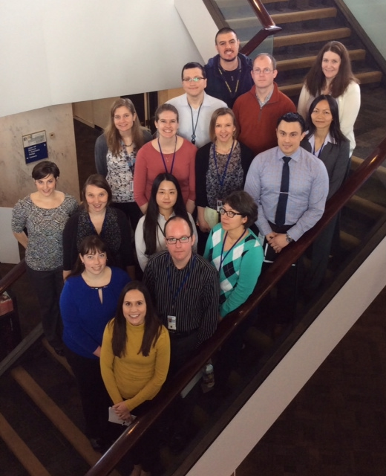
Pathways for Recent Graduates
Notes:
Pathways for Recent Graduates

Slide 61

NLM Associate Fellows 2014-2015
Erin Foster, Kristina Elliott, Lori Harris, Ariel Deardorff
Notes:
NLM Associate Fellows 2014-2015
Erin Foster, Kristina Elliott, Lori Harris, Ariel Deardorff

Slide 62



NLM Associate Fellows 2nd Year
Christian Minter, Welch Medical Library, Johns Hopkins Medical Institutions
Nicole Pettenati, Mayo Clinic, Arizona
Holly Thompson, Welch Medical Library, Johns Hopkins Medical Institutions
Notes:
NLM Associate Fellows 2nd Year
Christian Minter, Welch Medical Library, Johns Hopkins Medical Institutions
Nicole Pettenati, Mayo Clinic, Arizona
Holly Thompson, Welch Medical Library, Johns Hopkins Medical Institutions

Slide 63
2nd Year Host Proposals for NLM Associate Fellows 2015-2016
Donald C. Harrison Health Sciences Library, University of Cincinnati Libraries
August C. Long Health Sciences Library, Columbia University Medical Center
Greenblatt Library, Georgia Regents University
Health Sciences Library, Ohio State University
Oregon Health & Science University
Lane Medical Library, Stanford University
Library and Center for Knowledge Management, University of California, San Francisco
Spencer S. Eccles Health Sciences Library, University of Utah
Health Sciences Library, University of Washington
Tompkins-McCaw Library, Virginia Commonwealth University
Samuel J. Wood Library and the C.V. Starr Biomedical Information Center, Weill Medical College
Homer Stryker M.D. School of Medicine, Western Michigan University
Notes:
2nd Year Host Proposals
for NLM Associate Fellows 2015-2016
Donald C. Harrison Health Sciences Library, University of Cincinnati Libraries
August C. Long Health Sciences Library, Columbia University Medical Center
Greenblatt Library, Georgia Regents University
Health Sciences Library, Ohio State University
Oregon Health & Science University
Lane Medical Library, Stanford University
Library and Center for Knowledge Management, University of California, San Francisco
Spencer S. Eccles Health Sciences Library, University of Utah
Health Sciences Library, University of Washington
Tompkins-McCaw Library, Virginia Commonwealth University
Samuel J. Wood Library and the C.V. Starr Biomedical Information Center, Weill Medical College
Homer Stryker M.D. School of Medicine, Western Michigan University

Slide 64

NLM and RML Staff
Janet Zipser
soon to retire from NLM
Notes:
NLM and RML Staff
Janet Zipser soon to retire from NLM

Slide 65

Keep in touch
Visit booth #419 until 2:30 pm today
Follow us – email, Twitter, Facebook, etc
Notes:
Keep in touch
Visit booth #419 until 2:30 pm today
Follow us – email, Twitter, Facebook, etc

