Slide 1
PubMed® Tips and Tricks
Margaret McGhee
MEDLARS Management Section
Bibliographic Services Division
U.S. National Library of Medicine
U.S. National Institutes of Health
U.S. Department of Health and Human Services

Slide 2
Tips and Tricks
Use PubMed search box to find citations
Use My NCBI to customize your PubMed experience
Use Sidebar and My NCBI Filters
Notes:
In the few minutes we have this morning I am going to share some tricks about how to easily find citations and how to customize your PubMed experience.

Slide 3
Find Citations with Title Matching
Use the search box
Match titles
Save time
Notes:
Use the PubMed search box to quickly and easy find citations by title matching.

Slide 4

Title Matching
Notes:
I copied the title from another source and pasted it directly into the PubMed search box. There are multiple results but the message “See 1 citation found by title matching your search:” provides a link to the exact result I want.

Slide 5
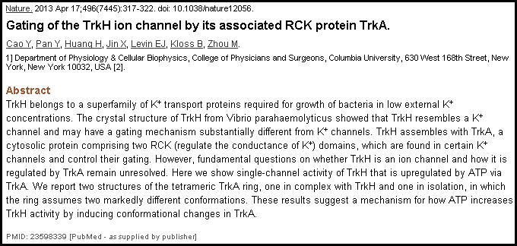
Title Matching Example
Notes:
In another example, I also copied the title from another source and pasted it directly into the PubMed search box. There is only one results so PubMed returns the exact abstract.

Slide 6
Use My NCBI
Highlight search terms
Recent Activity
Collections
Notes:
Use My NCBI to customize your PubMed experience. Highlight search terms in results, make sure you can recover your work, and use the same limits for every PubMed search.

Slide 7
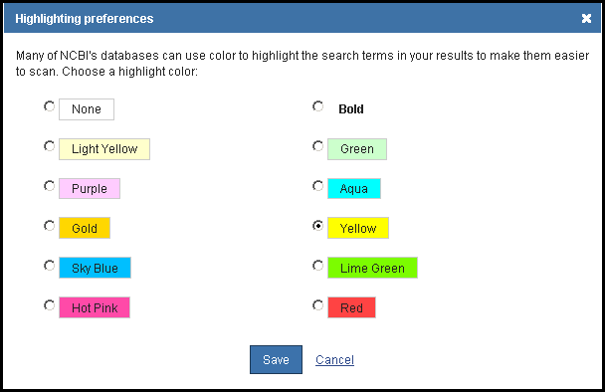
Highlight Search Terms
Notes:
In My NCBI select an eye-pleasing color and click Save.
Choices are:
None, light yellow, purple, gold, sky blue, hot pink, bold, green, aqua, yellow, lime green, red.

Slide 8
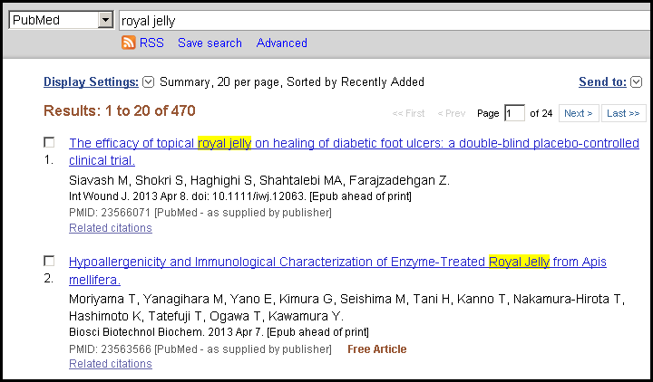
Highlight Example
Notes:
When signed in to My NCBI search terms are highlighted with the color you chose. Royal jelly is a honey bee secretion that is used for medicinal purposes.

Slide 9
Insure Yourself
Use Recent Activity – tracks your last six months of searches and abstract views
Use Collections instead of Clipboard – doesn’t expire after 8 hours of inactivity
Notes:
Use My NCBI to make sure you can access your work over longer periods of time.
Recent activity tracks your last six months of searches and abstract views.
Collections store PubMed items and don’t expire after 8 hours of inactivity.

Slide 10
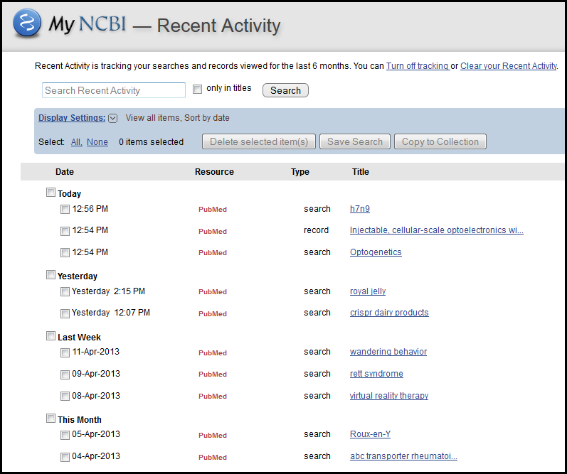
Search Recent Activity
Notes:
When signed in to My NCBI, Recent Activity records up to six months of searches and abstract views. This slide shows the My NCBI Recent Activity portlet. My searches from Today, Yesterday, Last Week, This Month, etc. are available.
Because six months of work would be difficult to look through, Recent Activity is searchable. Searching Recent Activity can help you easily find older work and abstracts viewed.
When not signed in to My NCBI, Recent Activity is a lot like History. It records searches and abstract views but the data expires after 8 hours of inactivity.

Slide 11
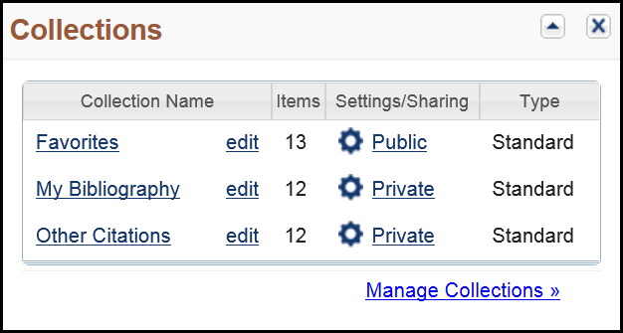
Collections
Notes:
Every My NCBI account comes loaded with three Collections shown here – Favorites, My Bibliography, and Other Citations. You can create as many Collections as you want and collect in each as many items as you need.
What’s really nice about collections is that you can make them public and share them with others.

Slide 12
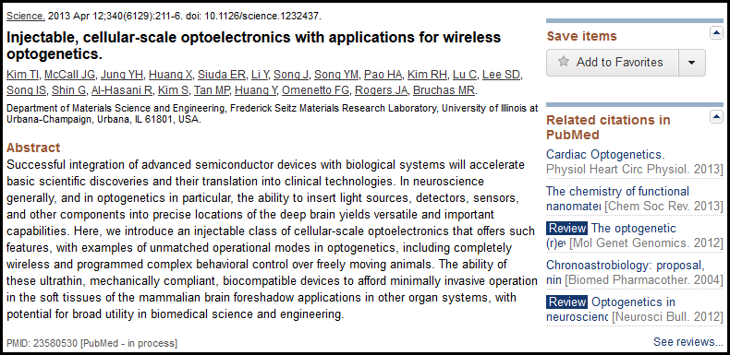
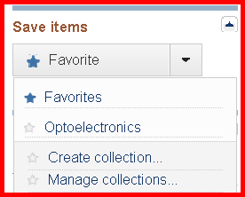
Collections Example
Notes:
When viewing a single PubMed abstract you can add an item to your Collections with just one click.
The Favorites collection is the default on this menu but the pull-down displays all your collections. I added this item to my Favorites collection as indicated by the star that is now blue.
When you want to add more than one item at a time, use the Send to Collections menu. All your collections including Favorites are listed in the Choose a collection menu.

Slide 13
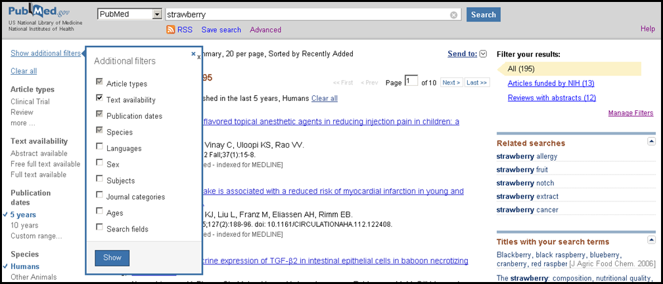
Filters
Notes:
On the PubMed results screen there are two places to apply filters or limits. On the Filters sidebar there are multiple selections. Here I’ve selected Published in the last 5 years and Humans. If I want additional filters that are not available by default I click Show additional filters for the complete menu.
Custom filters are available when signed into My NCBI. They are in the upper right corner of the results page.

Slide 14
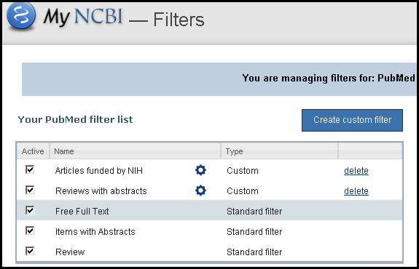
Create Your Custom Filters
Notes:
Creating custom filters is easy. In the My NCBI Filters portlet, click Create custom filter.

Slide 15
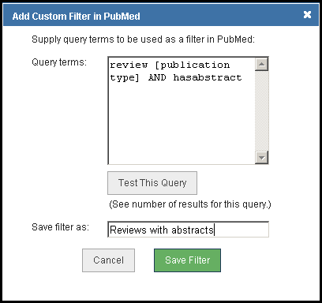
Create Your Custom Filters Example
Notes:
Enter your search terms, test them, name the filter and save it.
For this filter, I combined review [pt] AND hasabstract to create my own filter that I named Reviews with abstracts.

Slide 16
Questions?
Questions?

