Slide 1

Integrated Information and Data from – and for – an Interdependent World
NLM Update – Part 1
Betsy L. Humphreys
Deputy Director
US National Library of Medicine
National Institutes of Health
Department of Health & Human Services
blh@nlm.nih.gov

Slide 2
Connected Priorities
Global Opportunities and Challenges
Public access to research results
Clinical research transparency
Interoperable electronic health records (EHRs)
Clinical/public health use of genomic data
Management and use of “Big Data” from all of the above

Slide 3
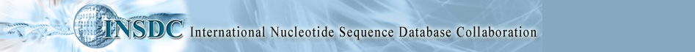
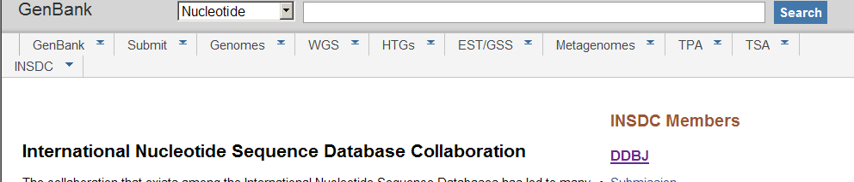
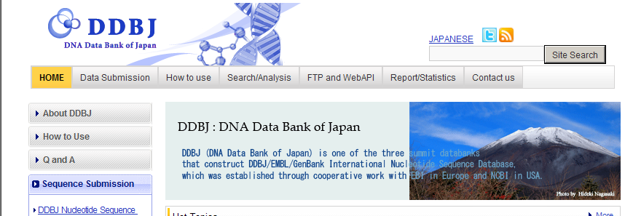
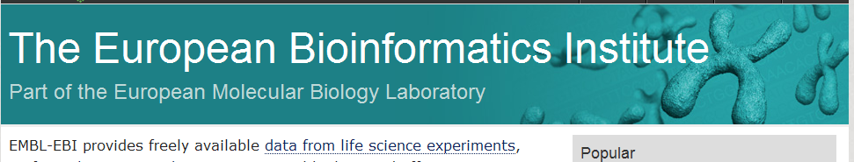
First (1980s) - there was public access to research data– promoted by research funders with help from journal editors

Slide 4
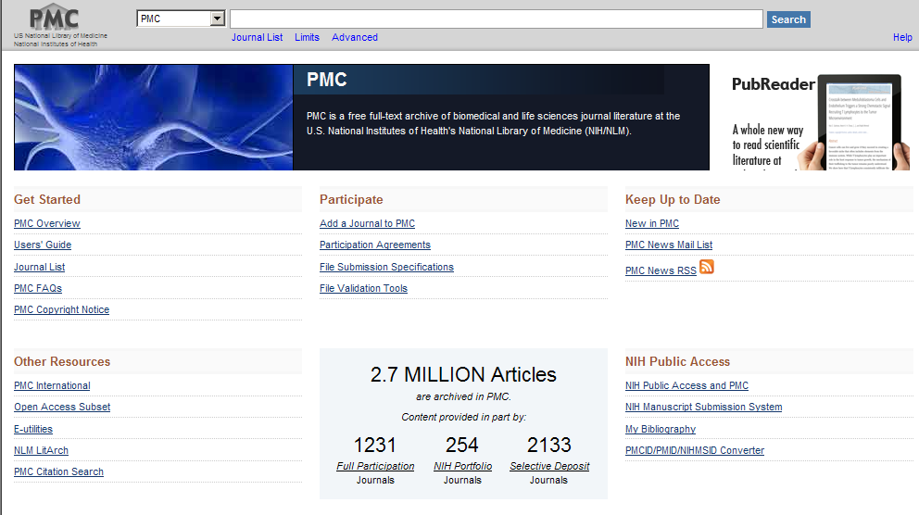
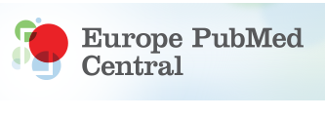
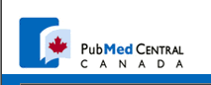
Then the emphasis shifted to peer-reviewed research articles ….
Notes:
As of 2013-05-01
Total Full-text Free Full-text
All 22709190 60.54% 17.46%
1990- 13807488 79.72% 27.01%
2000- 9414373 88.68% 24.77%
2010- 3030377 92.72% 27.12%
Last 1yr 1018765 93.15% 17.78%
Last 6m 568325 92.86% 14.60%

Slide 5
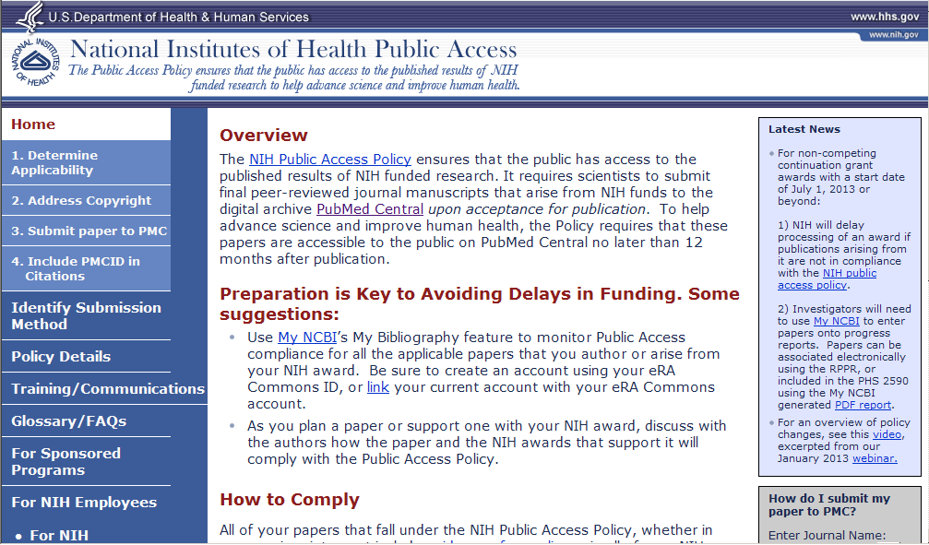
Recent added incentive for NIH-funded authors….
Related presentation at NLM exhibit booth: 1:30 pm

Slide 6
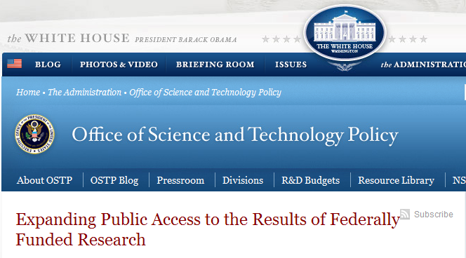
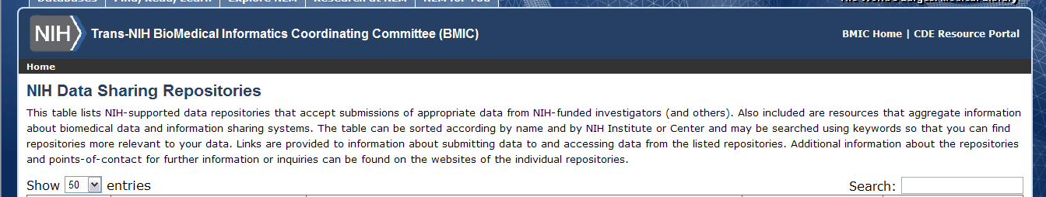
Now the focus is on biomedical data and peer-reviewed articles…
More in “MLA Scholarly Communications & Legislative Update” at 1:30 pm, HCC #312
NLM will keep you updated re: new NIH “Big Data to Knowledge (BD2K)” initiatives & funding
← New data resource – thanks to Kevin Read, NLM Associate Fellow

Slide 7
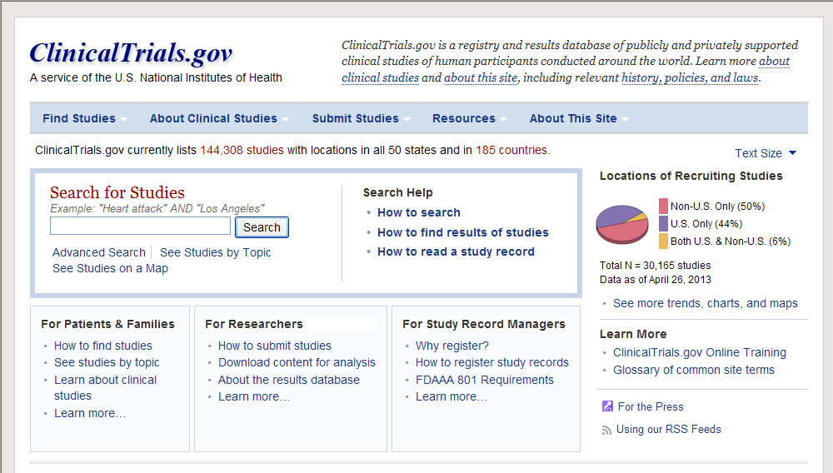
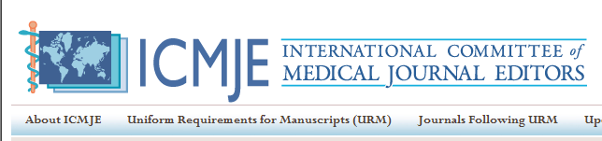
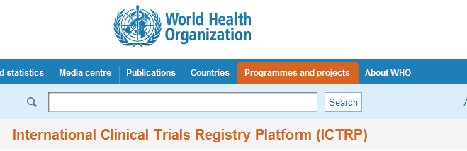
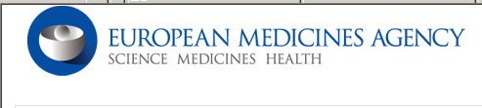
Clinical Research Transparency – another facet of public access

Slide 8
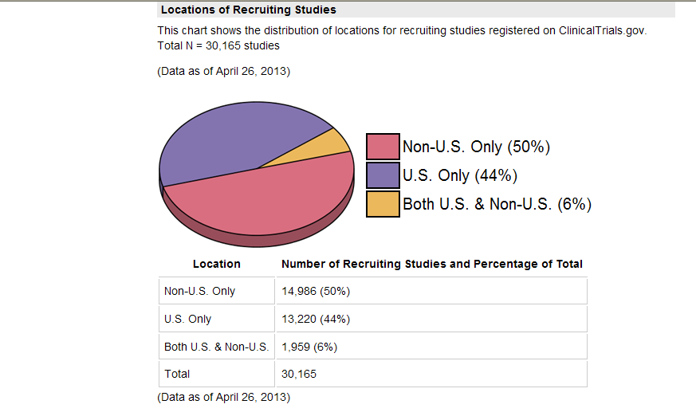
ClinicalTrials.gov: a new window on the clinical research enterprise
More than 144,000 studies registered from 185 countries
Presentation at NLM exhibit booth: 11:30 am
Notes:
Pie chart of locations of recruiting studies. Total 301635, data as of April 26, 2013.
Location - Non-US only = 14986 (50%)
US only = 13220 (44%)
Both US and non US = 1959 (6%)

Slide 9
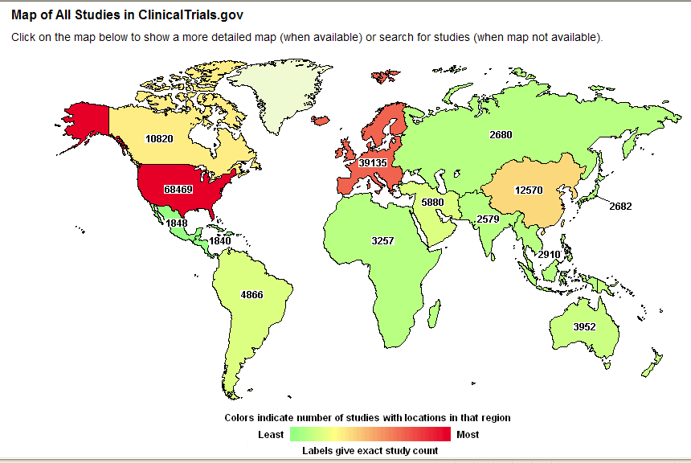
Map of all studies in ClinicalTrials.gov

Slide 10

But it can be viewed from a national perspective ….

Slide 11
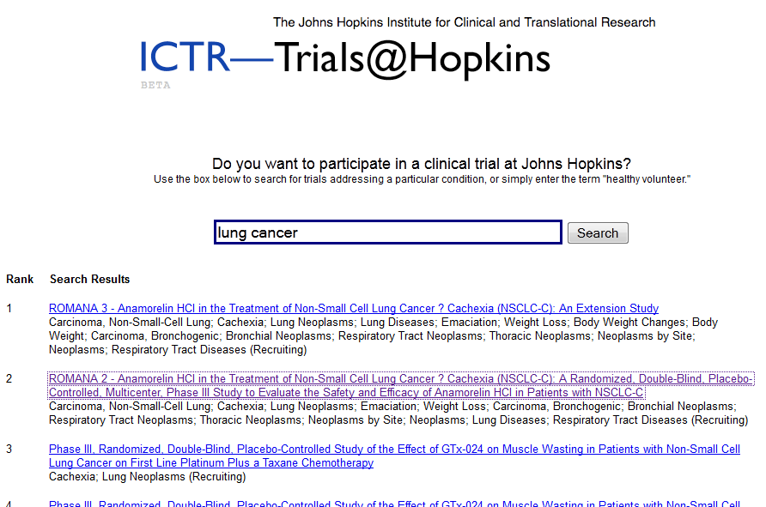
Or an institutional perspective…

Slide 12
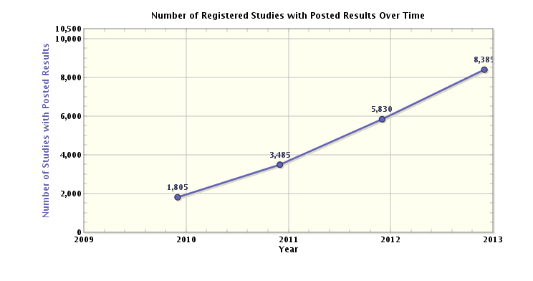
ClinicalTrials.gov is a unique source of summary results for many trials
Notes:
ClinicalTrials.gov. Graph of number of registered studies with posted results over time.
X-axis = number of studies with posted results
y-axis = year 2009 – 2013
2010 = 1805
2011 = 3485
2012 = 5830
2013 = 8385

Slide 13
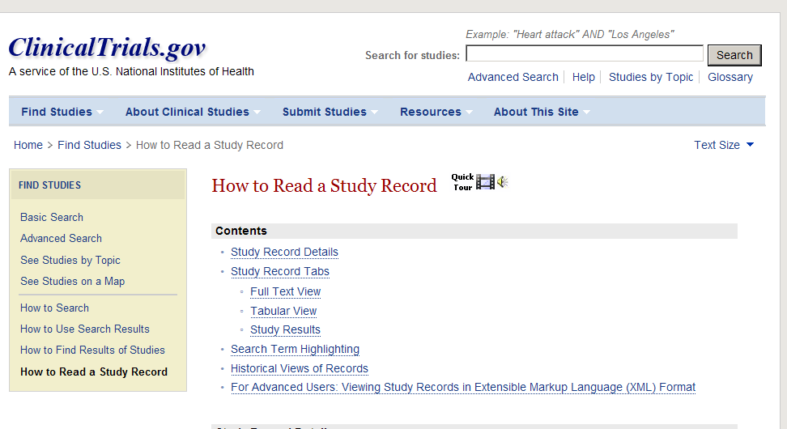
There are user resources, but…
Coming soon from NN/LM:
Training for Librarians re: ClinicalTrials.gov Results

Slide 14
Standardization makes information more usable by humans and computers
A lesson learned LONG ago by librarians is gaining traction in international health care and research circles
If health care & research converge on common international standards, benefits could be great
Beyond MeSH, NLM supports/develops clinical vocabularies for EHRs (& includes all in UMLS)
  SNOMED CT, LOINC (lab tests, other clinical measurements), RxNorm (medications)
Related presentation at NLM exhibit booth: 12:30 pm

Slide 15
IHTSDO: INTERNATIONAL HEALTH TERMINOLOGY STANDARDS DEVELOPMENT ORGANISATION
Owns, delivers SNOMED Clinical Terms (SNOMED CT)
  Free licenses/use in Member countries
  Low-cost licenses for institutions in other countries
    Free in poorest countries
    Free for “public good” applications
  Scope includes animals, as well as humans
International not-for-profit association
  Based in Denmark
  One Member per country
  Governed by General Assembly of its Members
  Management Board elected by GA
  Funded by countries based on national wealth (GNI)

Slide 16
Current IHTSDO Members – more likely soon
NLM is the Member for the USA

Slide 17
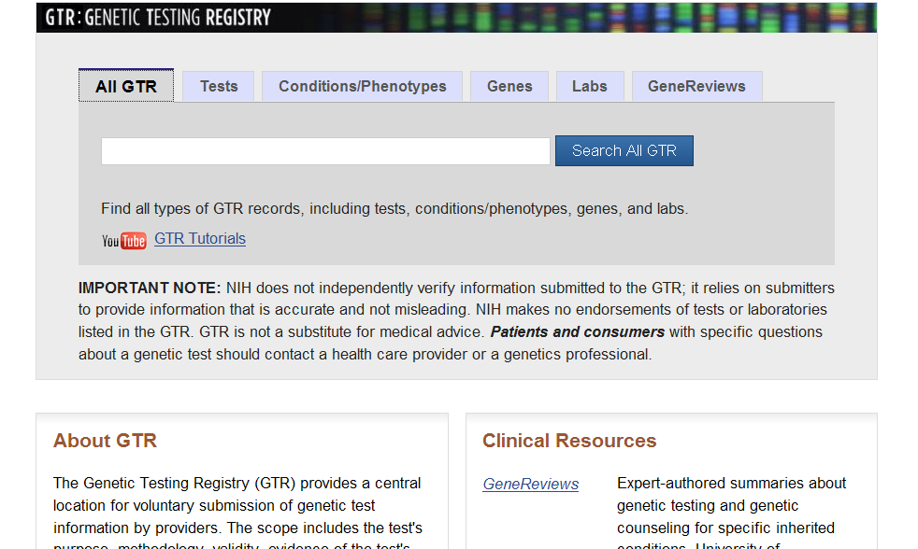
Genetic testing registry
As of 30 April 2013:
3,005 tests registered by 290 laboratories in
37 countries

Slide 18
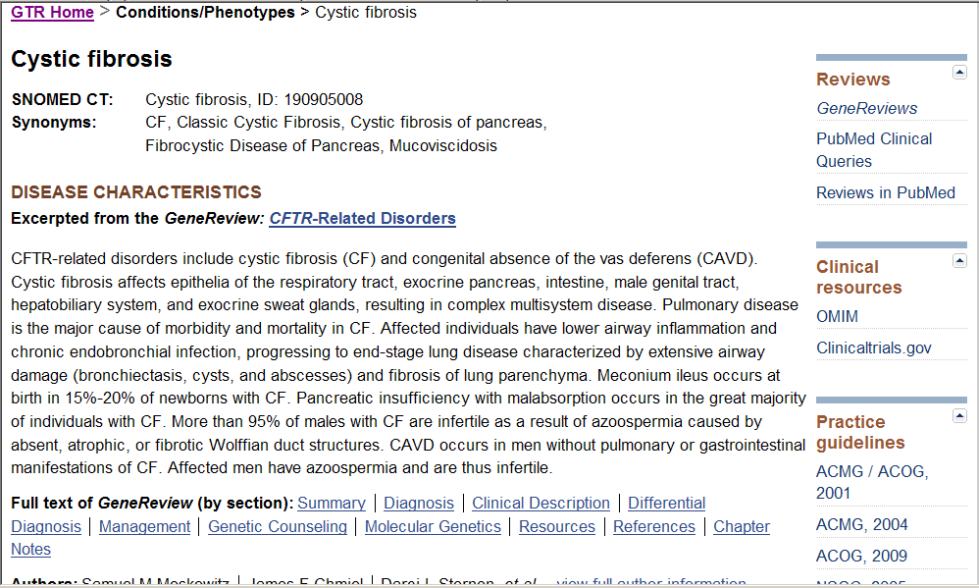
Useful links for EHRs

Slide 19
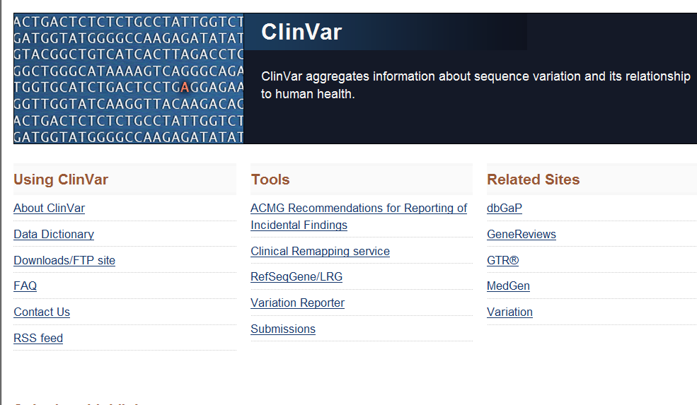
International standard for location of genetic variations

Slide 20
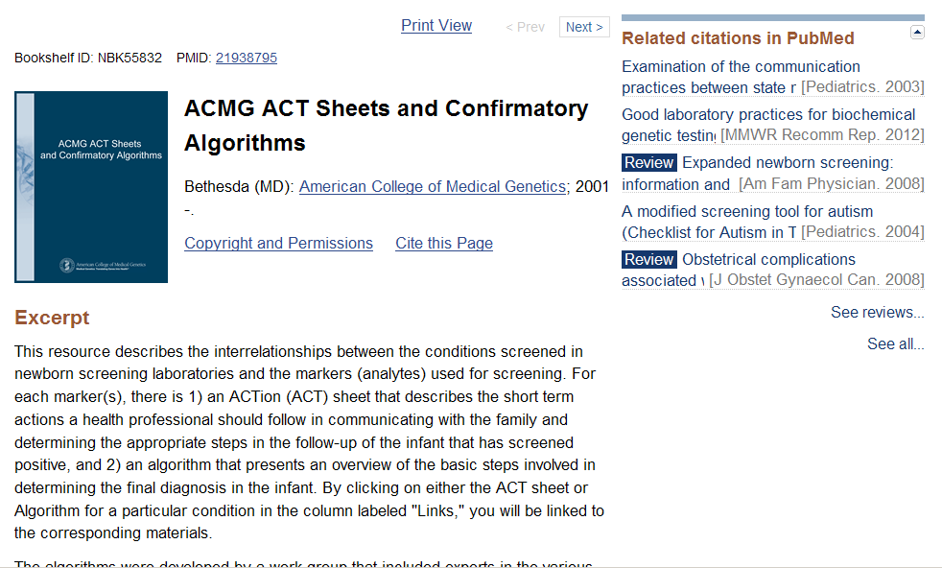
More digitized guidelines
Related presentation at NLM Booth:
What’s New @ PubMed Health, 2:30 pm

Slide 21
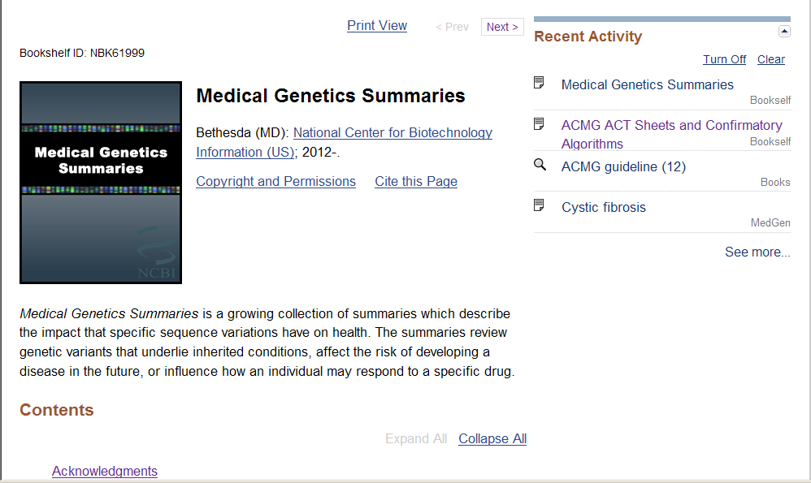
New synthesized content

Slide 22
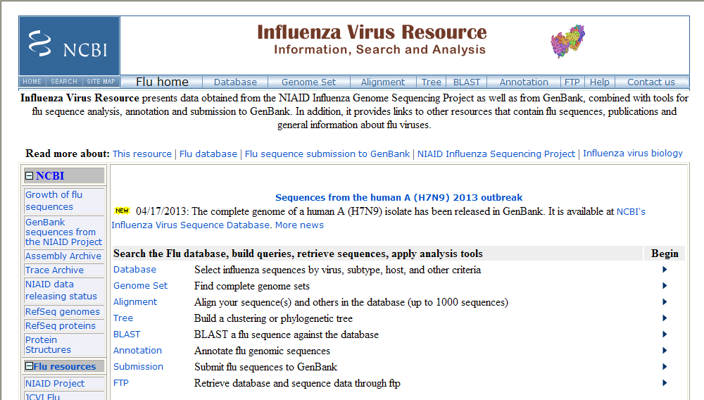
A prime example of
“One Health”

Slide 23
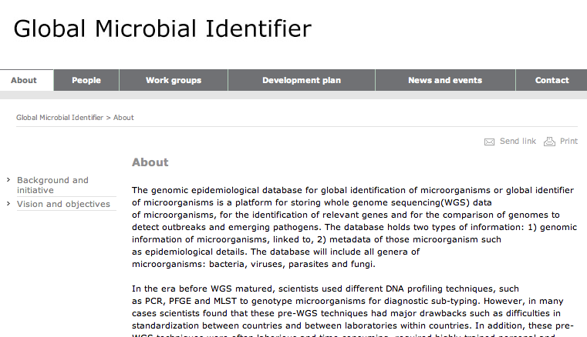
And another on the horizon – a new NCBI database in development

Slide 24
FY 2013 NLM Budget (April 23, 2013)
  $326.3 million – minus 5.5% or $19.2 million from FY 2012
  Plus $30+M transfers from NIH for NCBI
  Plus other usual interagency transfers for health data standards, AIDsinfo, etc.

Slide 25
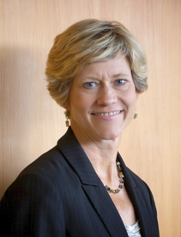
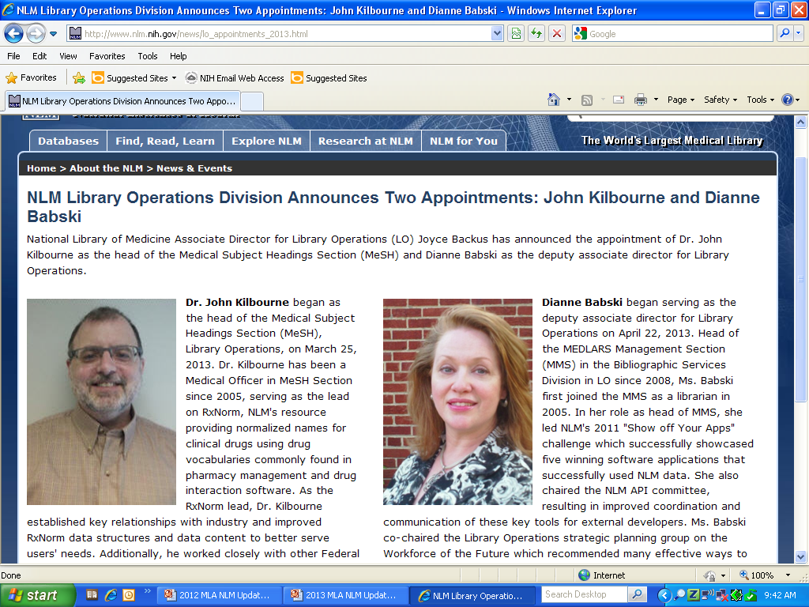
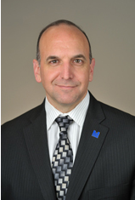
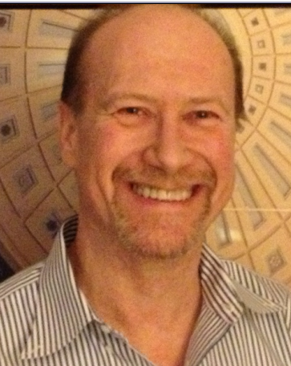
People are the most important resource
~ Some Recent NLM Appointments ~
Joyce Backus, MSLS
Associate Director for
Library Operations
Dianne Babski, MIS
Deputy Associate Director
for Library Operations
Dan Gerendasy, Ph,D.
Chief, International Programs,
Office of Health Information Programs
Development
Ken Koyle, MA, M.Ed
Deputy Chief, History of
Medicine Division
Library Operations
John Kilbourne, MD
Head, Medical Subject Headings
Library Operations

Slide 26
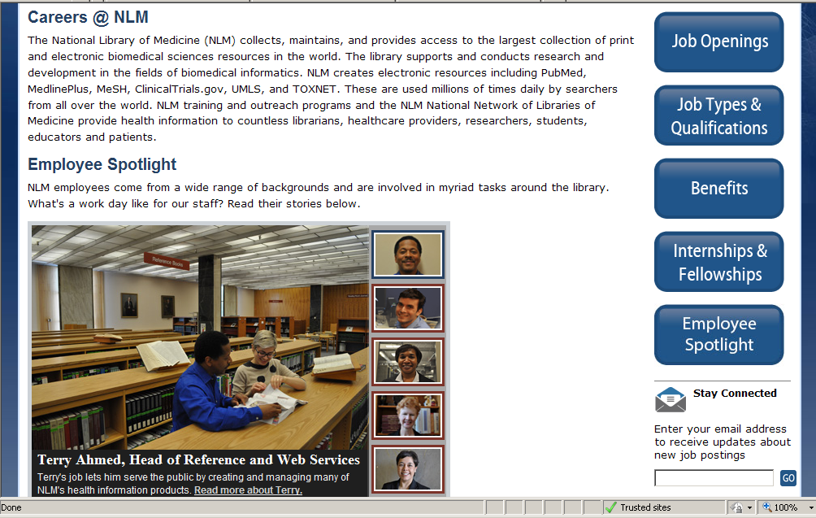
http://www.nlm.nih.gov/careers/careers.html#

