Slide 1
Medical Library Association Annual Meeting
NLM Update
May 22, 2012
Seattle, WA
Jeffrey S. Reznick, PhD
Chief, History of Medicine Division, NLM

Slide 2
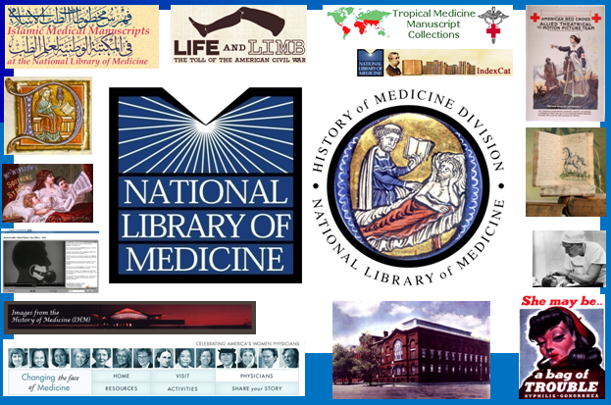
Collage of History of Medicine images

Slide 3

Native Voices

Slide 4
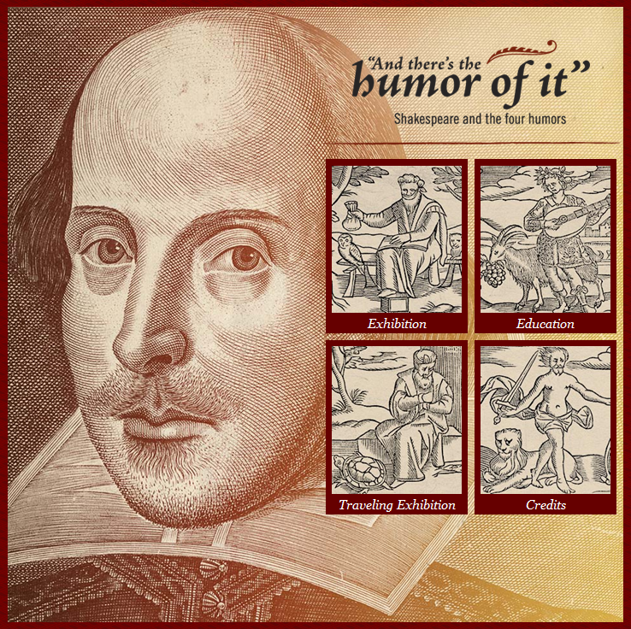
Humor of it

Slide 5
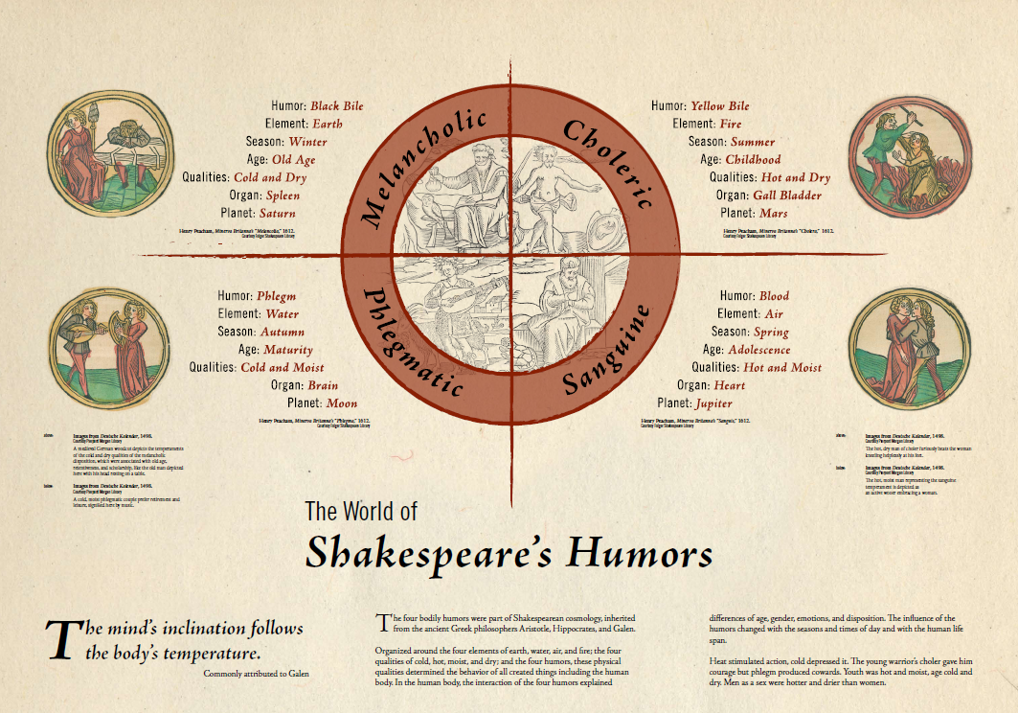
The World of Shakespeare’s Humors

Slide 6
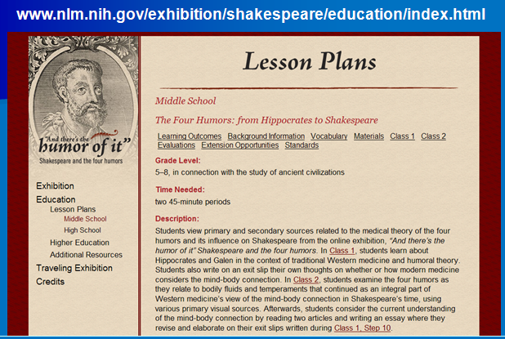
Lesson plans

Slide 7
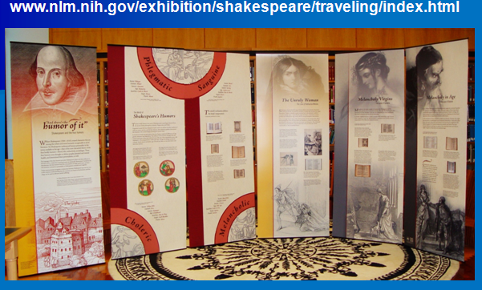
Humor of it exhibit

Slide 8
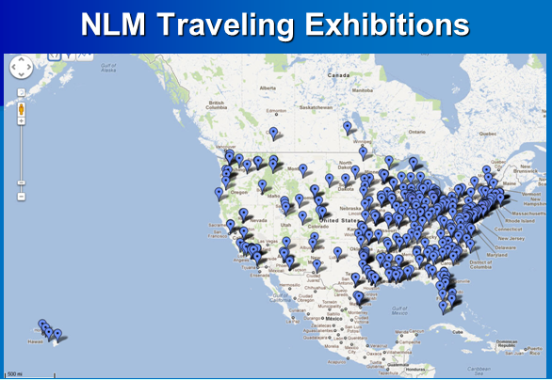
NLM traveling exhibitions

Slide 9
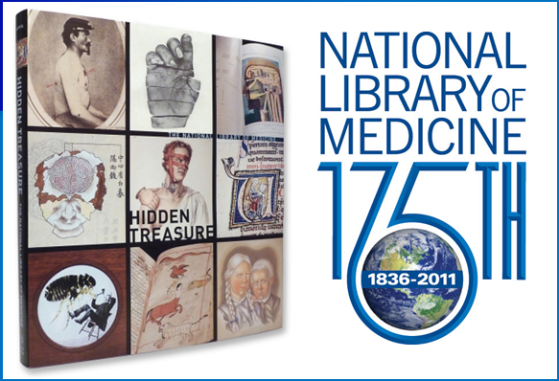
NLM 175th anniversary

Slide 10
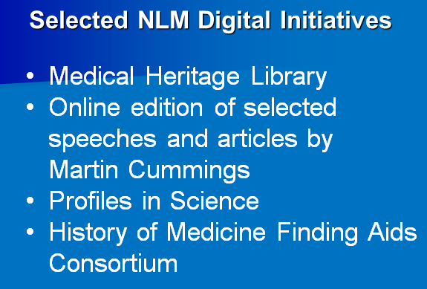
Selected NLM Digital Initiatives

Slide 11
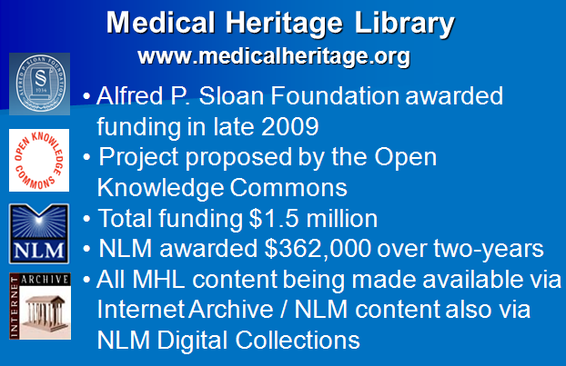
Medical Heritage Library

Slide 12
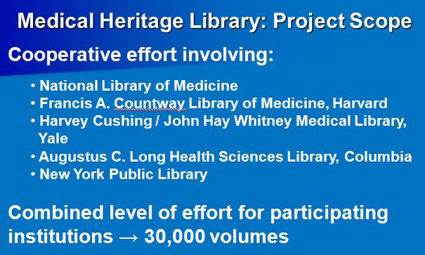
Medical Heritage Library: Project Scope

Slide 13
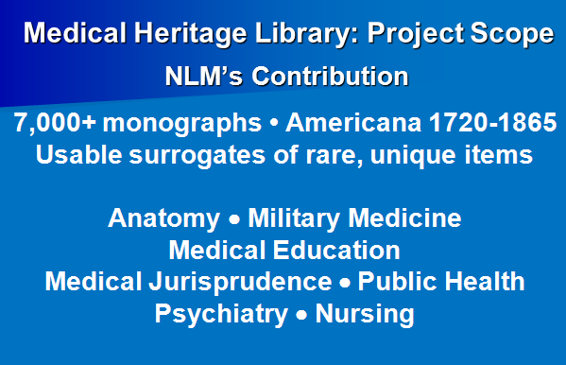
Medical Heritage Library: Project Scope

Slide 14
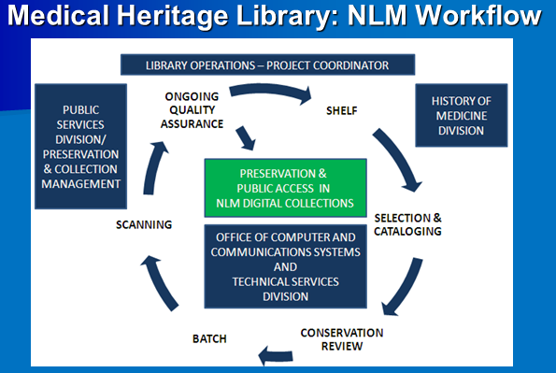
Medical Heritage Library: NLM Workflow

Slide 15
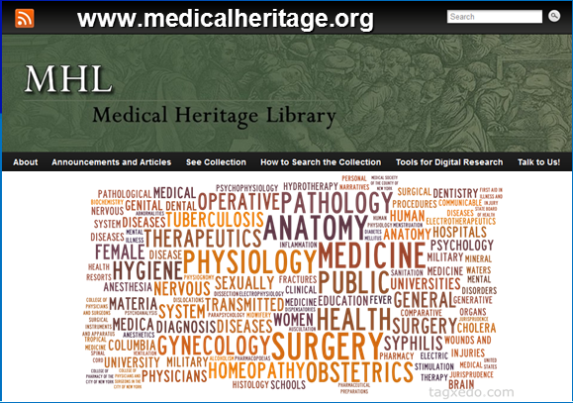
Medical Heritage Library

Slide 16
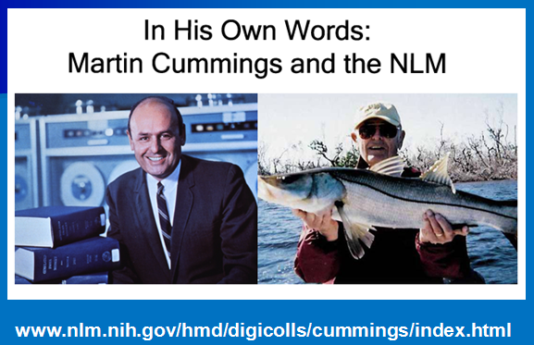
Martin Cummings

Slide 17
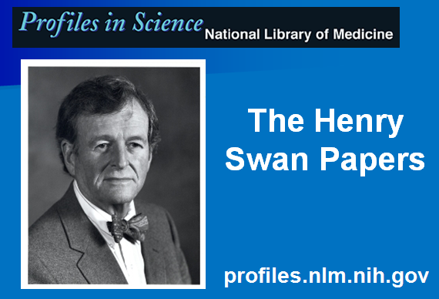
Profiles in Science

Slide 18
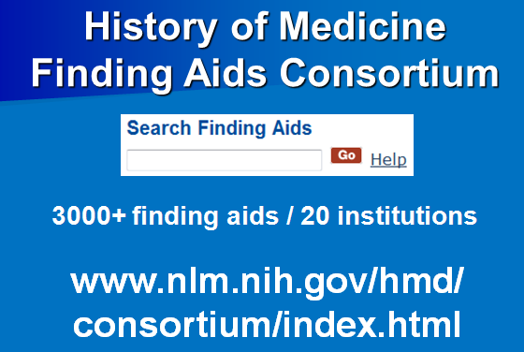
History of Medicine Finding Aids Consortium

Slide 19
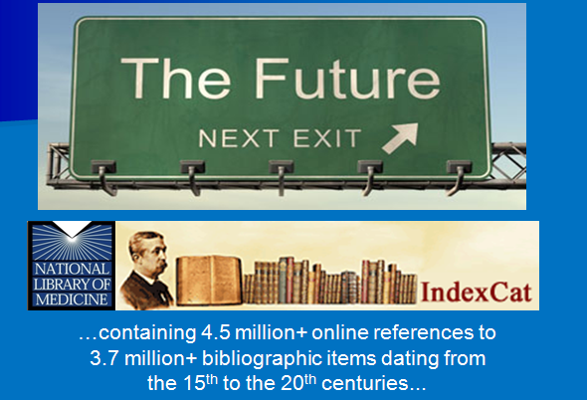
The future

Slide 20

Thank you

