Slide 1
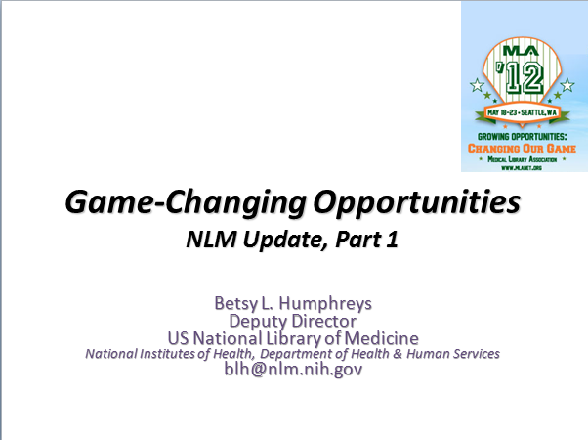
Game-Changing Opportunities

Slide 2
Our Joint Playing Field:
A Few Constants
Change
Our missions (if defined properly)
Importance of Community Engagement
Human Nature

Slide 3
Our Joint Playing Field:
Constantly changing
Knowledge relevant to medicine and health
Information volume, format, availability, cost
Information technology & delivery channels
Environments in which information is used
User expectations & needs
Government policy affecting all of the above

Slide 4
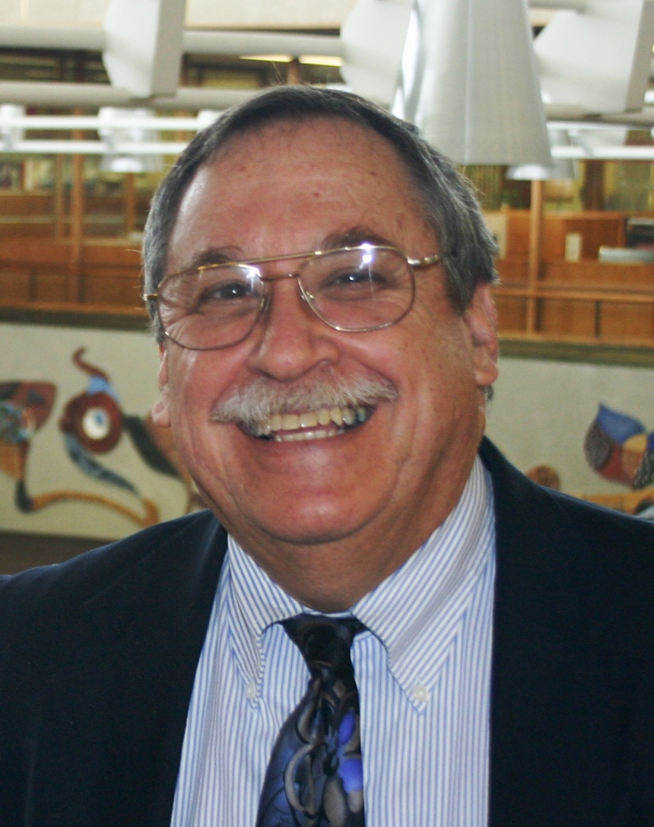
No longer an NLM constant …
Sheldon Kotzin, FMLA
-arrived at NLM in 1968
-will retire, June 2012
“… a long and fruitful career that has enhanced the lives of countless individuals, shaped the landscape of medical information services, and improved the public health.”
from NLM Board of Regents Resolution, May 2012

Slide 5
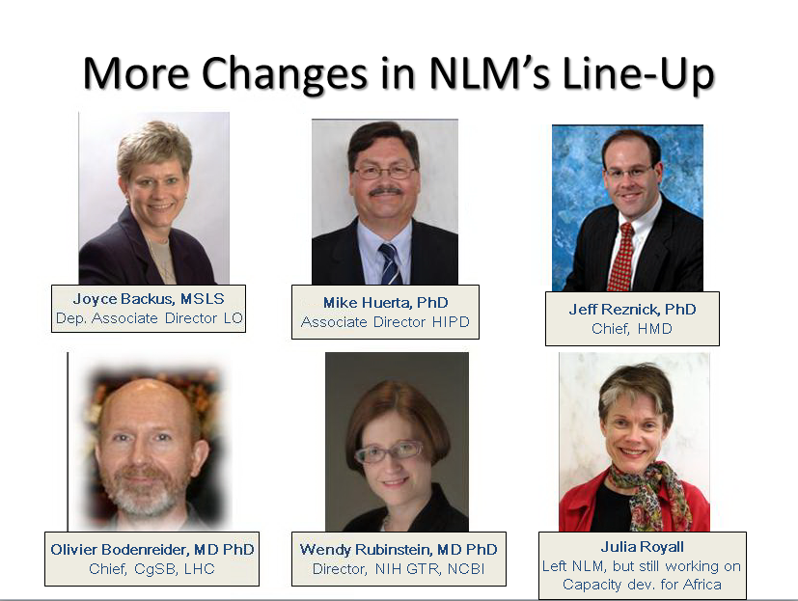
More Changes in NLM’s Line-Up

Slide 6
One Joint Opportunity:
ARRA HITECH (2/09) established:
(among many other things)
Incentives for Medicare/Medicaid providers to implement and demonstrate “meaningful use” of “certified” electronic health records (EHRS)
  Incentives began - 2011
  Non-use penalties begin – 2016

Slide 7
“Meaningful Use”– key players
Centers for Medicare and Medicaid Services (CMS)
  Eligibility, payment, Meaningful Use criteria
Office of the National Coordinator for Health Information Technology (ONC)
  EHR Certification Criteria
National Institute of Standards and Technology (NIST)
  Certification Test Procedures

Slide 8
“Meaningful Use” Basics
Slightly different criteria for Eligible Professionals/Hospitals, Medicare/Medicaid
Requirements escalate: 2011, 2014 (proposed), 20??
  Core (Mandatory) & Menu (can select from these)
Requirements in many areas, e.g.,
  Patient data capture, Orders, Clinical decision support, Exchange of patient data, Information for patients, Quality measures, Privacy/security protections
Must use certified electronic health record product(s)
Must use health data standards to meet some criteria

Slide 9
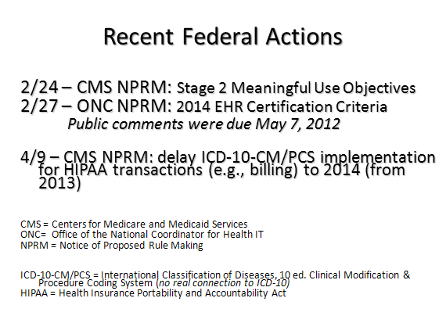
Recent Federal Actions
Notes:
9

Slide 10
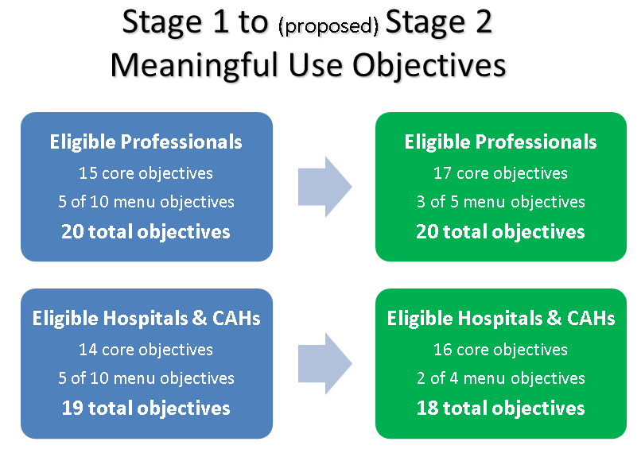
Stage 1 to (proposed) Stage 2
Meaningful Use Objectives
Notes:
10

Slide 11
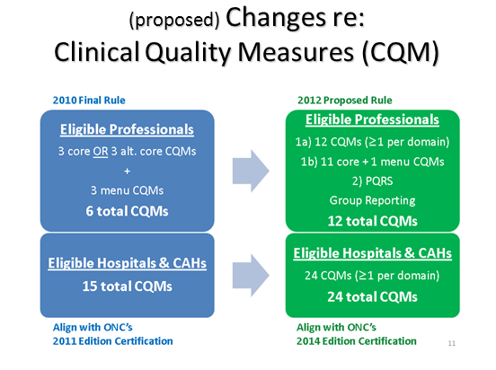
(proposed) Changes re: Clinical Quality Measures (CQM)

Slide 12
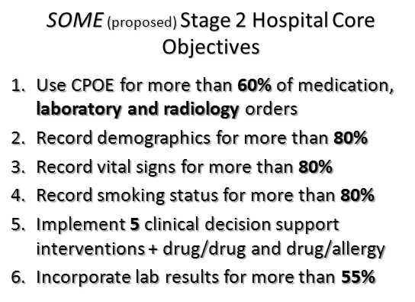
SOME (proposed) Stage 2 Hospital Core Objectives
Notes:
12

Slide 13
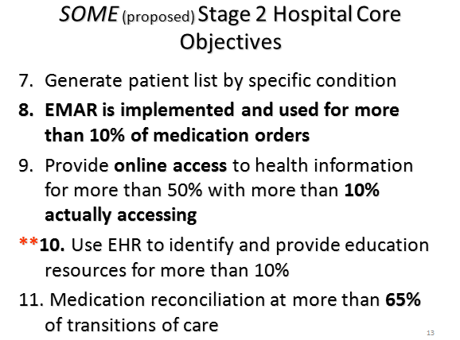
SOME (proposed) Stage 2 Hospital Core Objectives
Notes:
13

Slide 14
Types of Standards in (proposed)
2014 EHR Certification Criteria
Transport (New)
Functional (New) , e.g.,
  Reference Source -HL7 Context-Aware Knowledge Retrieval (Infobutton) Standard
  NOTE: standard access to external information sources = opportunity re: resource identification, selection, acquisition
Content Exchange (Revised)
Vocabularies/Code Sets (Revised)

Slide 15
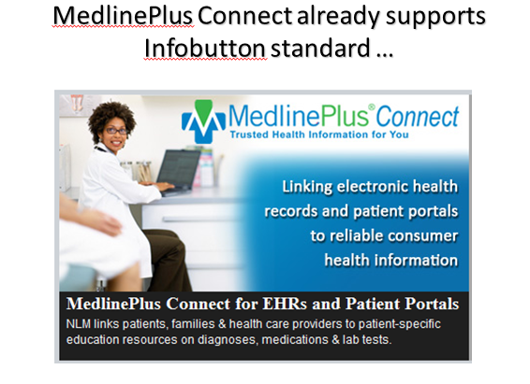
MedlinePlus Connect already supports Infobutton standard …

Slide 16
Types of Standards in (proposed)
2014 EHR Certification Criteria
Transport (New)
Functional (New) , e.g.,
  Clinical Quality Measures -NQF Quality Data Model,2011
  (requires use of SNOMED CT, RxNorm, LOINC in vocabulary value sets that define measure parameters)
  NOTE: opportunities re: EHR data element and terminology mapping, best practice evidence,
Content Exchange (Revised)
Vocabularies/Code Sets (Revised)

Slide 17
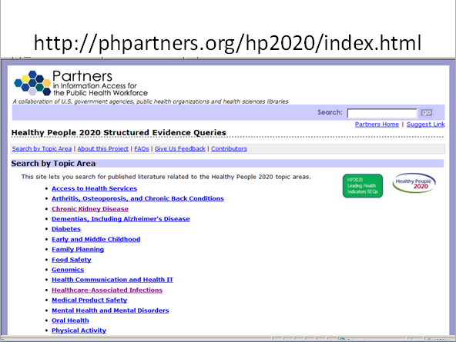
http://phpartners.org/hp2020/index.html

Slide 18
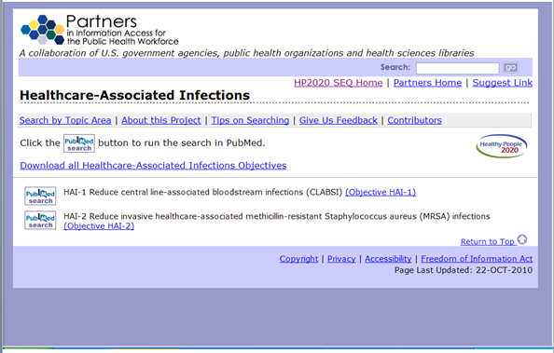
Partners in information access for the public health workforce

Slide 19
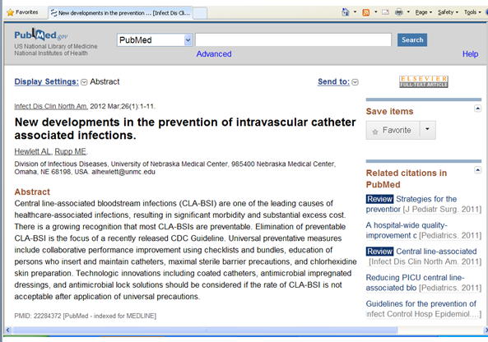
PubMed Screen Shot

Slide 20
Types of Standards in (proposed)
2014 EHR Certification Criteria
Transport (New)
Functional (New)
Content Exchange (Revised)
Vocabulary/Code Sets (Revised)

Slide 21
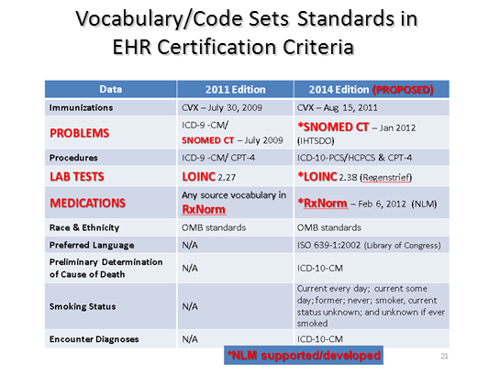
Vocabulary/Code Sets Standards in
EHR Certification Criteria
Notes:
21

Slide 22
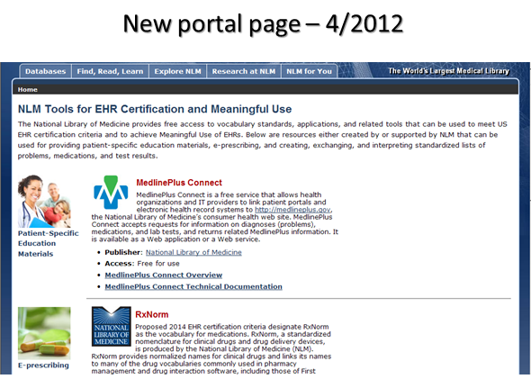
New portal page – 4/2012

Slide 23
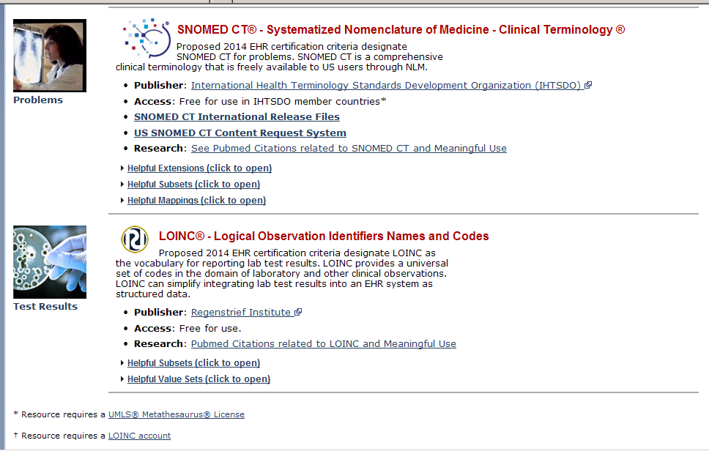
SNOMED, LOINC

Slide 24
Vocabulary Subsets/Additions to facilitate implementation
LOINC (tests & measurements) – Regenstrief
  Universal Lab Order Subset (300+)
  Top 2000+ Lab Observations & Mapper’s Guide
  Additions: genetic tests, patient assessment instruments, common data elements/valid values
RxNorm (medications) – NLM
  Current Prescribable Drugs (US)
  RxTerms - interface terminology for prescribing
  Additions: More over the counter drugs (OTCs), more NDCs,

Slide 25
Vocabulary Subsets to facilitate implementation
SNOMED CT (International Health Terminology Standards Development Organisation (IHTSDO))
  CORE Problem List Subset (5,862 concepts)
    Most frequently seen problems from 7 institutions
  Nursing Problem Subset
  Route of Administration Subset
  Kaiser Permanente’s Convergent Medical Terminology subsets

Slide 26
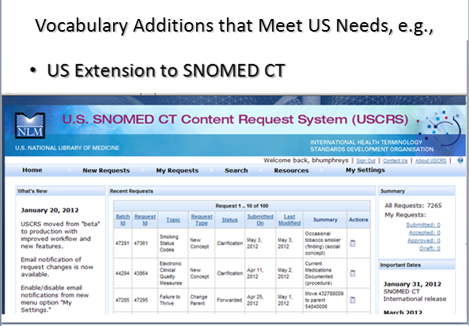
Vocabulary Additions that Meet US Needs, e.g.,

Slide 27
Upcoming SNOMED CT Expansions
Medical devices – via IHTSDO agreement (4/2012) with Global Medical Device Nomenclature Agency
Dental – via IHTSDO agreement (4/2012) with American Dental Association & NLM

Slide 28
Mappings to promote/facilitate implementation/transition
SNOMED CT to ICD-10-CM
  Feb. 2012 : From 7,277 concepts (CORE subset + others) with I-MAGIC demo tool
  June 2012: From ~15,000 concepts
ICD-9-CM to SNOMED CT
  May 2012: From 8,334 codes (~90% of use based on 2009 CMS data)

Slide 29
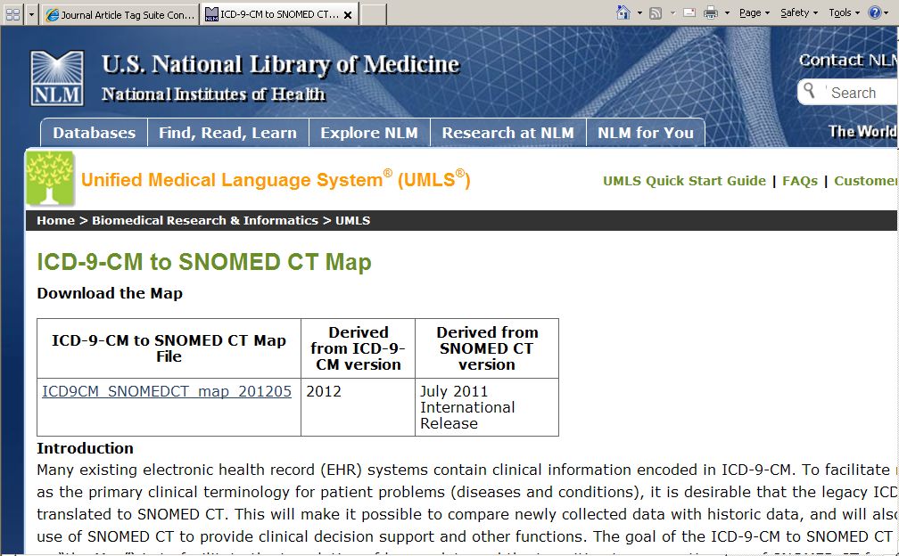
UMLS ICD-9-CM to SNOMED CT Map

Slide 30
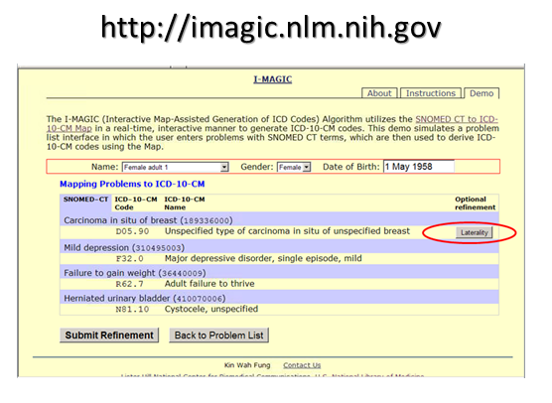
http://imagic.nlm.nih.gov

Slide 31
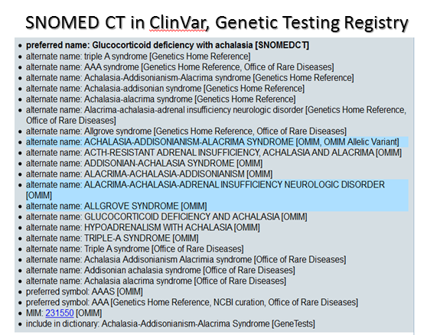
SNOMED CT in ClinVar, Genetic Testing Registry

Slide 32
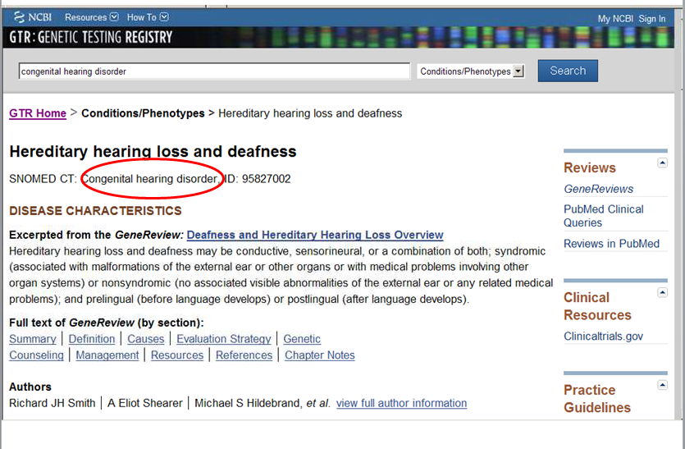
Genetic Testing Registry
Congenital Hearing Disorder

Slide 33
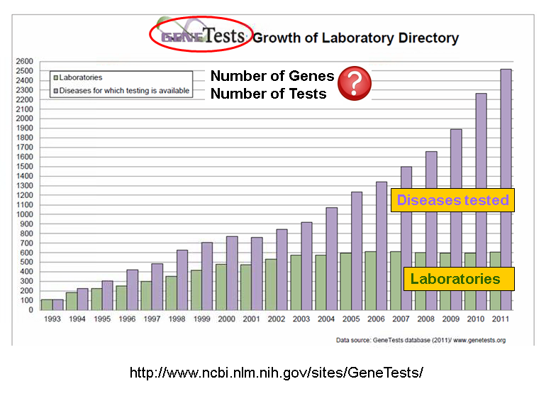
GeneTests Growth of Laboratory Directory

Slide 34
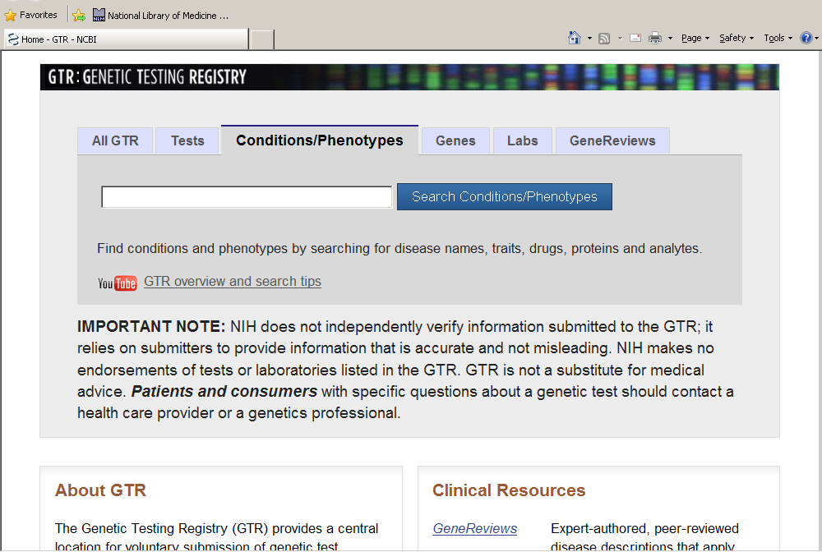
Genetic Testing Registry
Conditions/Phenotypes

Slide 35
EHRs & EHR Standards ↔
Clinical & Translational Research
Normalizing health data for use in research
Identifying patient cohorts from EHRs
Using “common data elements” & standard vocabularies in research
  An increasing NIH & NLM focus
Opportunity: Many researchers have little knowledge/some misconceptions re: EHR standards & common data elements

Slide 36
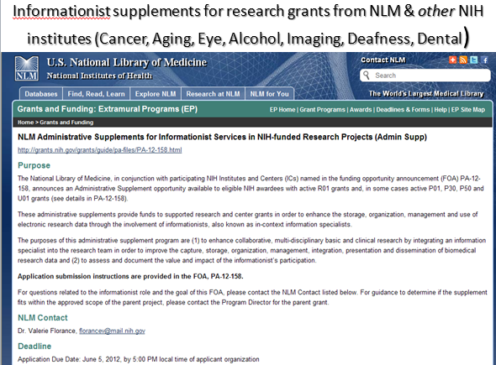
Informationist supplements for research grants from NLM & other NIH institutes (Cancer, Aging, Eye, Alcohol, Imaging, Deafness, Dental)

Slide 37
Enhanced Support – for system/apps developers, researchers … & for you
Consolidated customer service point:
  Terminology QA and User Services Unit (in MEDLARS Managment Section, BSD)
More/better documentation & educational resources on the Web
More Webinars
Greater NLM presence at HIMSS, other meetings & events that attract system developers

Slide 38
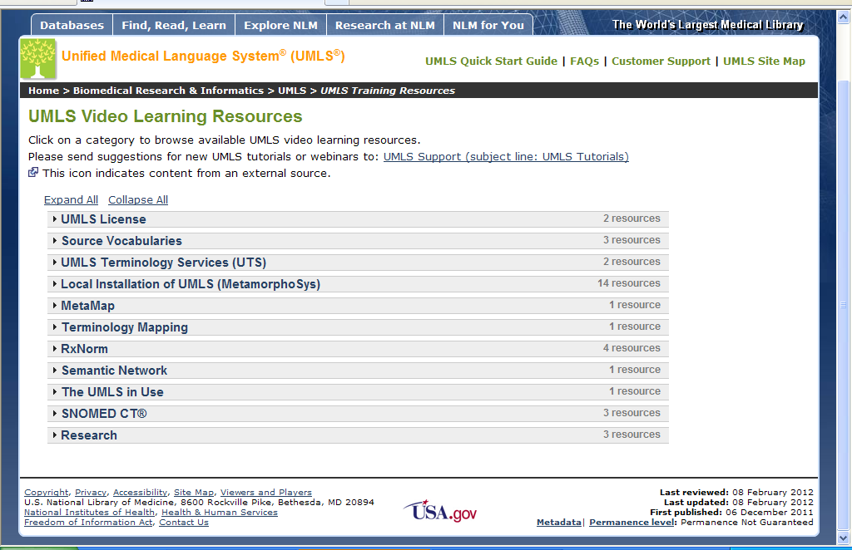
UMLS Video Learning Resources

Slide 39
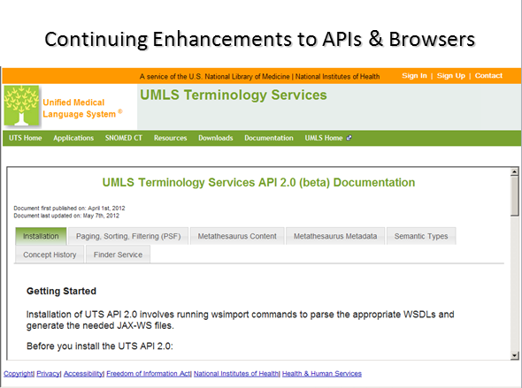
Continuing Enhancements to APIs & Browsers

Slide 40
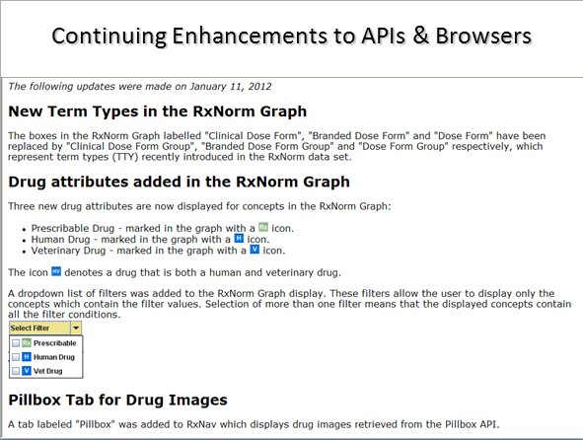
Continuing Enhancements to APIs & Browsers

Slide 41
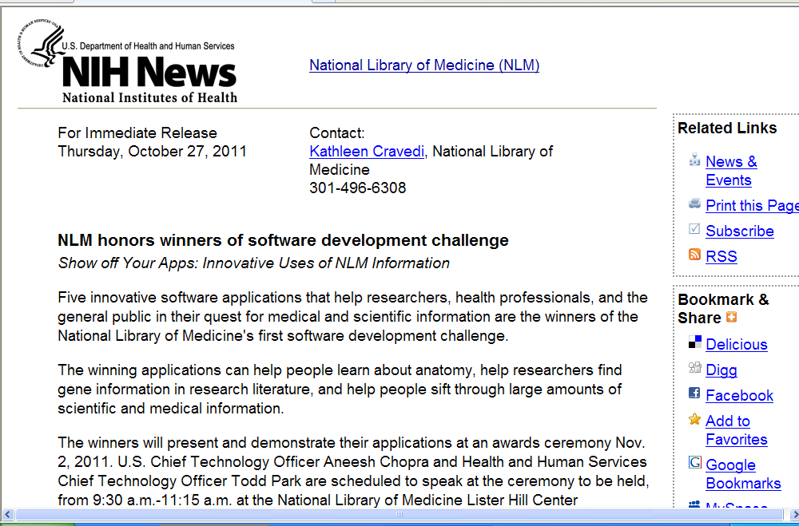
Show off your Apps

Slide 42
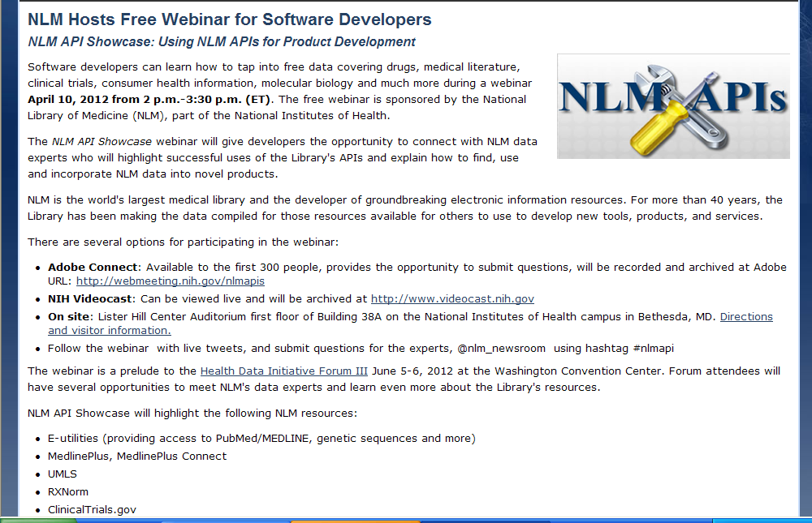
NLM API Showcase

Slide 43
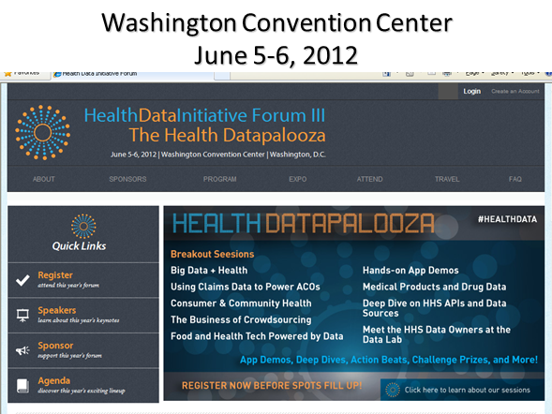
Washington Convention Center
June 5-6, 2012

Slide 44
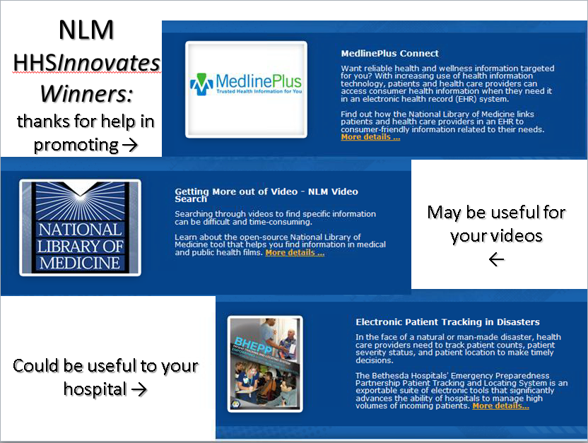
NLM HHSInnovates Winners

Slide 45
Health Literacy
Opportunities for us in many contexts:
  Health care, Research, Professional Education, Public Health, Information Outreach
Informed consent – a health literacy issue that cuts across health care, research, & use of EHRs

Slide 46
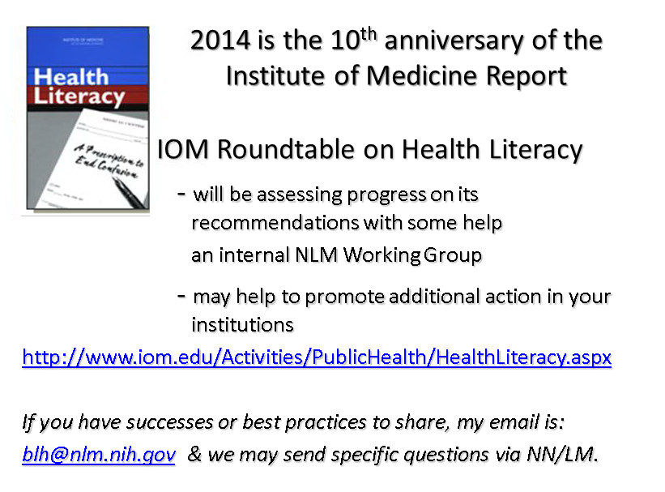
Institute of Medicine Report

Slide 47
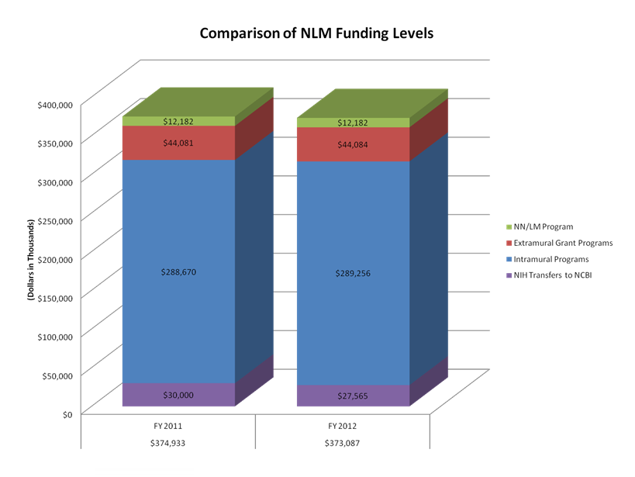
Comparison of NLM Funding Levels

Slide 48
Our Joint Playing Field:
Constantly changing
Knowledge relevant to medicine and health
Information volume, format, availability, cost
Information technology & delivery channels
Environments in which information is used
User expectations & needs
Government policy affecting all of the above

Slide 49
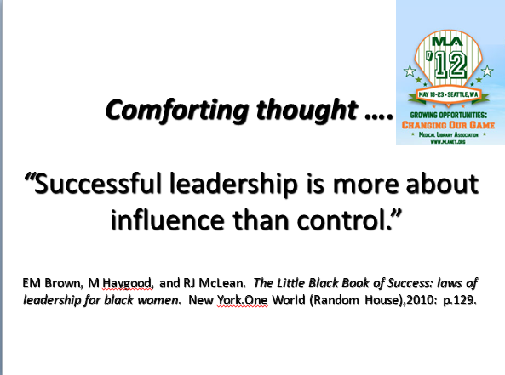
Successful leadership is more about influence than control

